Slide 1

Business Office Clinic
Non-Appropriated Funds (NAF)
& Auxiliary Funds
November 23, 2015
SBPA Building, Room 261

Slide 2

Account Structure
Example:
26-2F-120010-A-5200510

Slide 3
Account Structure
Fund: 26-2F-120010-A-5200510
Source: 26-2F-120010-A-5200510
Unit: 26-2F-120010-A-5200510
Function: 26-2F-120010-A-5200510
Object: 26-2F-120010-A-5200510

Slide 4
Funds
10 Local
26 Indirect Costs
27 Discretionary Cost
28 Non-Appropriated Funds (NAF)
41 Auxiliary
42 Unrestricted Non-Auxiliary

Slide 5
Account Structure
Fund: 26-2F-120010-A-5200510
Source: 26-2F-120010-A-5200510
Unit: 26-2F-120010-A-5200510
Function: 26-2F-120010-A-5200510
Object: 26-2F-120010-A-5200510

Slide 6
Account Structure
Example:
26-2F-120010-A-5200510
Fund: Discretionary
Source: 2016 Federal
Unit: CNHS
Function: Academic Support
Object: Travel

Slide 7
Account Structure
Another Example:
28-34-720599-T-5201505
Fund: Non-Appropriated Funds
Source: Continuing, Other Activity (Non-local/Fed)
Unit: Business Office
Function: Institutional Support
Object: Office Supplies and Materials

Slide 8
Funds
26 Indirect Costs
27 Discretionary Cost
28 Non-Appropriated Funds (NAF)
41 Auxiliary
42 Unrestricted Non-Auxiliary

Slide 9
26 - Indirect Costs
Where are these funds from?
- Revenues from Federal Grants
What can these funds be used for?
- Expenses for Unit/department to meet their objective

Slide 10
27 – Discretionary Funds
Where are these funds from?
- Salary Buy-outs
What can these funds be used for?
- Expenses for Unit/department to meet their objective

Slide 11
28 – Non-Appropriated Funds
Where are these funds from?
- Revenue from income generated by departments
What can these funds be used for?
- Expenses for Unit/department to meet their objective

Slide 12
41 – Auxiliary
Where are these funds from?
Revenue generated by departments
  Bookstore, Housing/Dorm, ELI, Calvo Fieldhouse
What can these funds be used for?
Expenses for Unit/department to meet their objective

Slide 13
42 – Non-Auxiliary
Where are these funds from?
Revenue generated by departments;
  PIP, SGA, CLASS, Student Health Services
What can these funds be used for?
Expenses for Unit/department to meet their objective

Slide 14
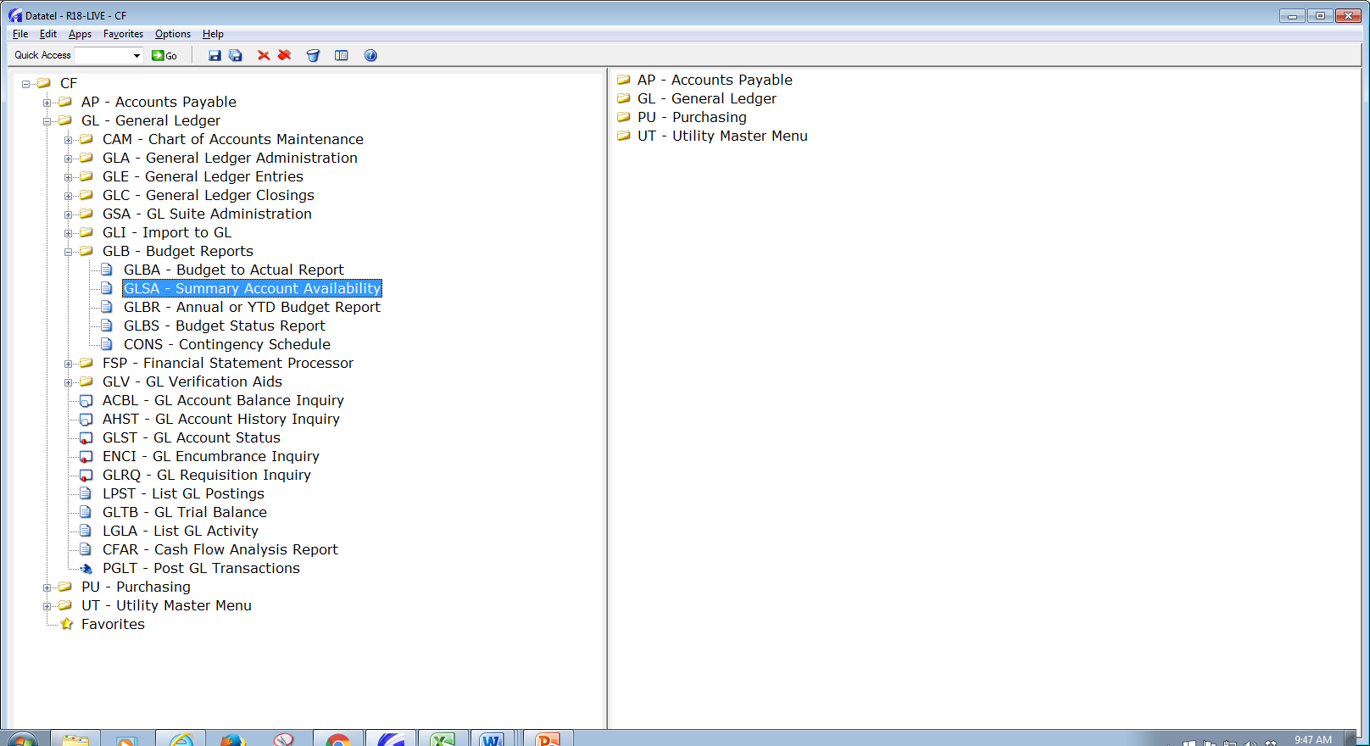

Slide 15
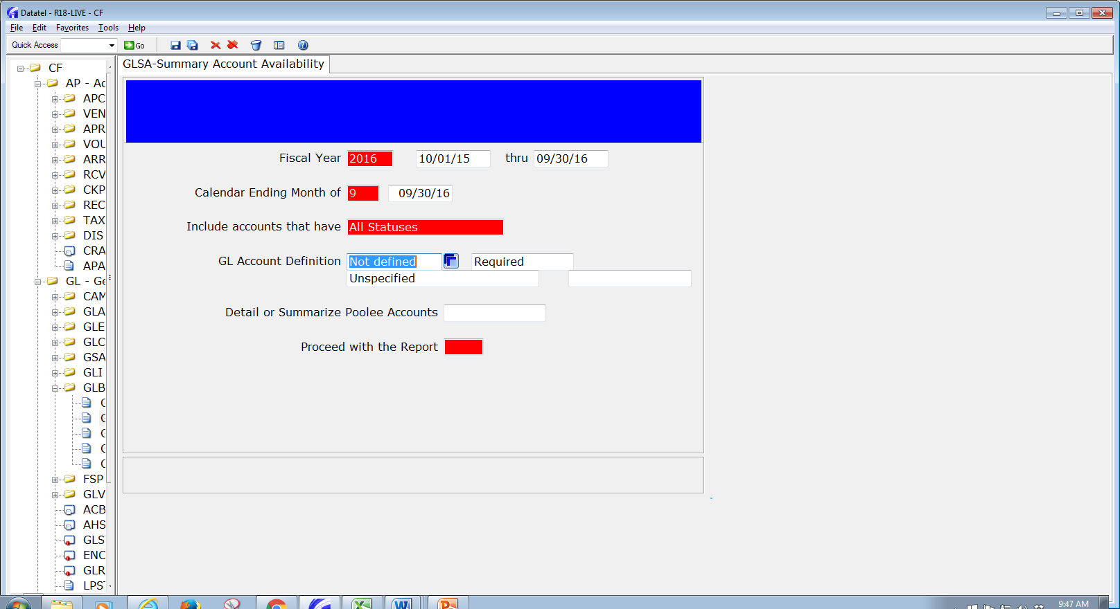

Slide 16
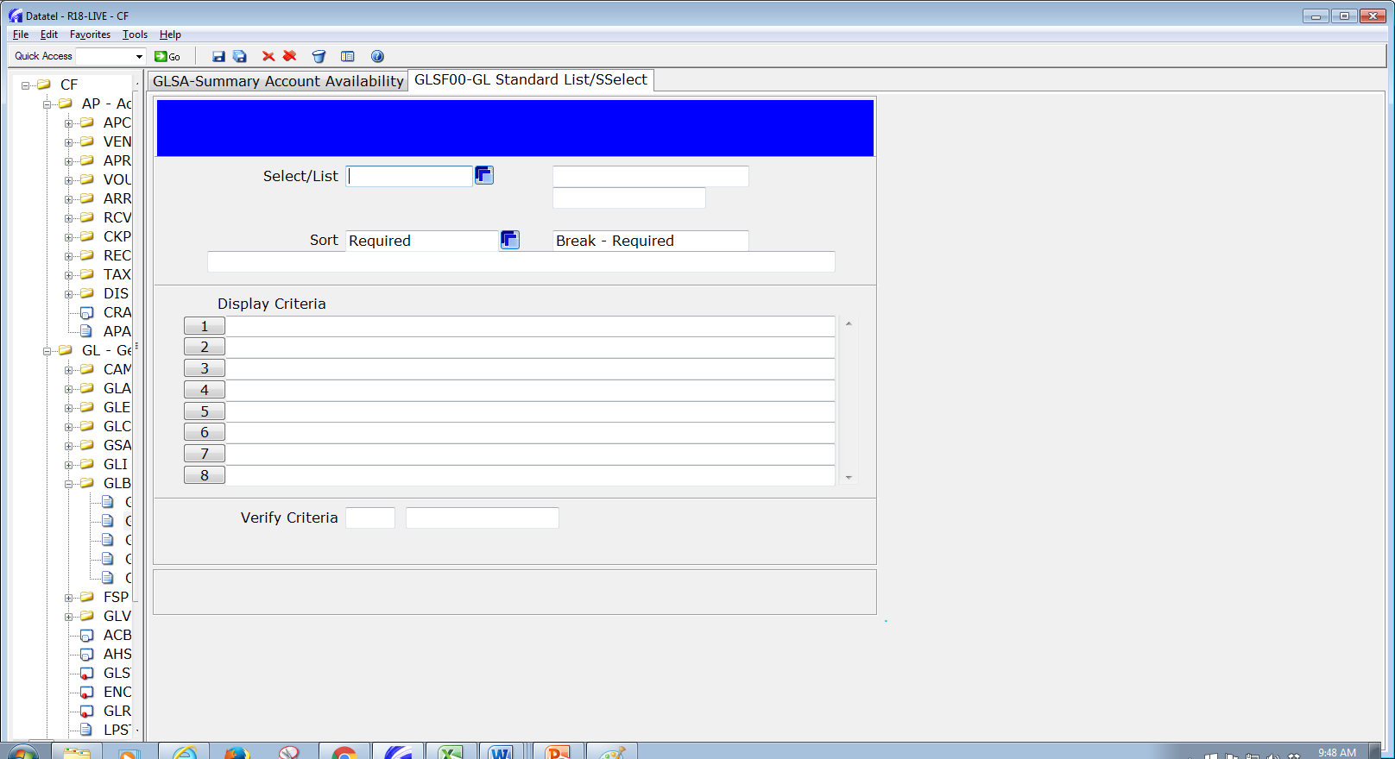

Slide 17
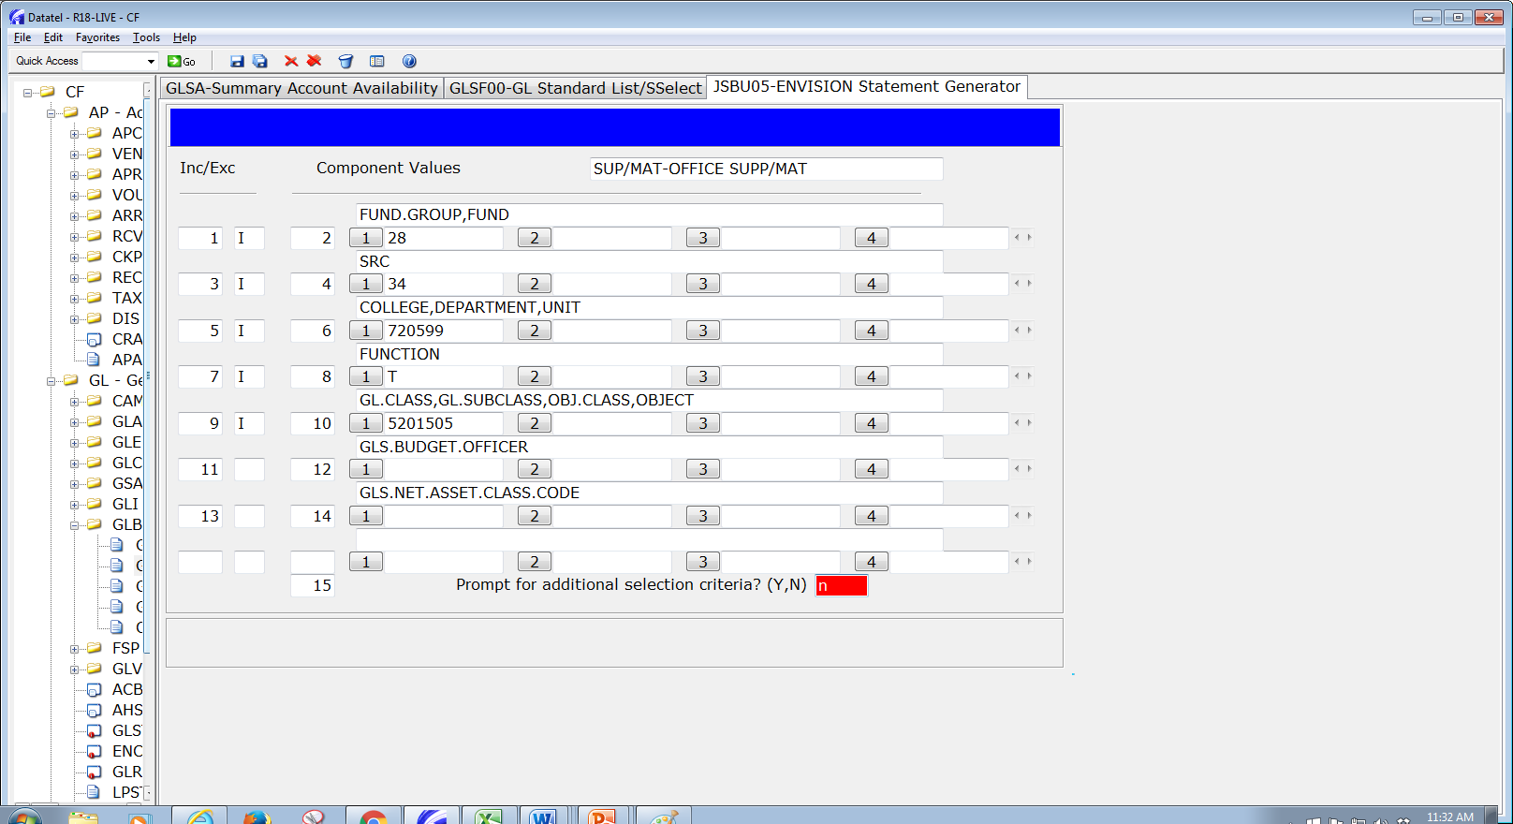

Slide 18
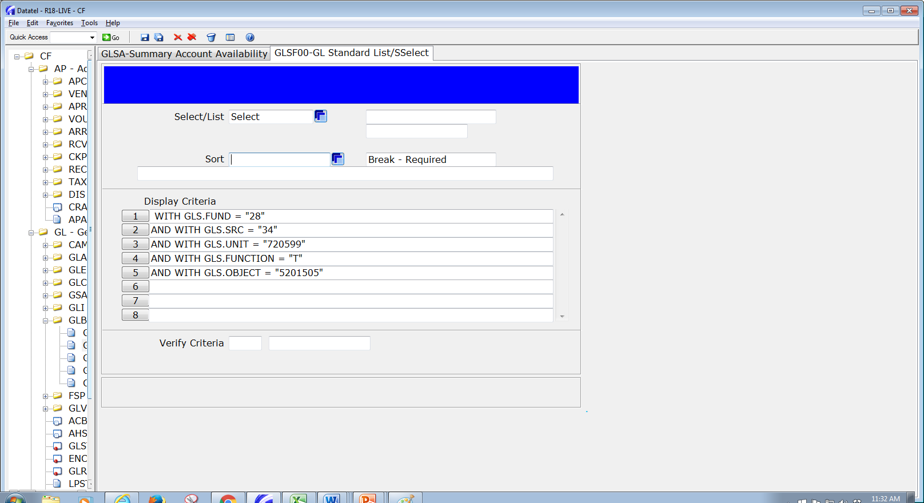

Slide 19
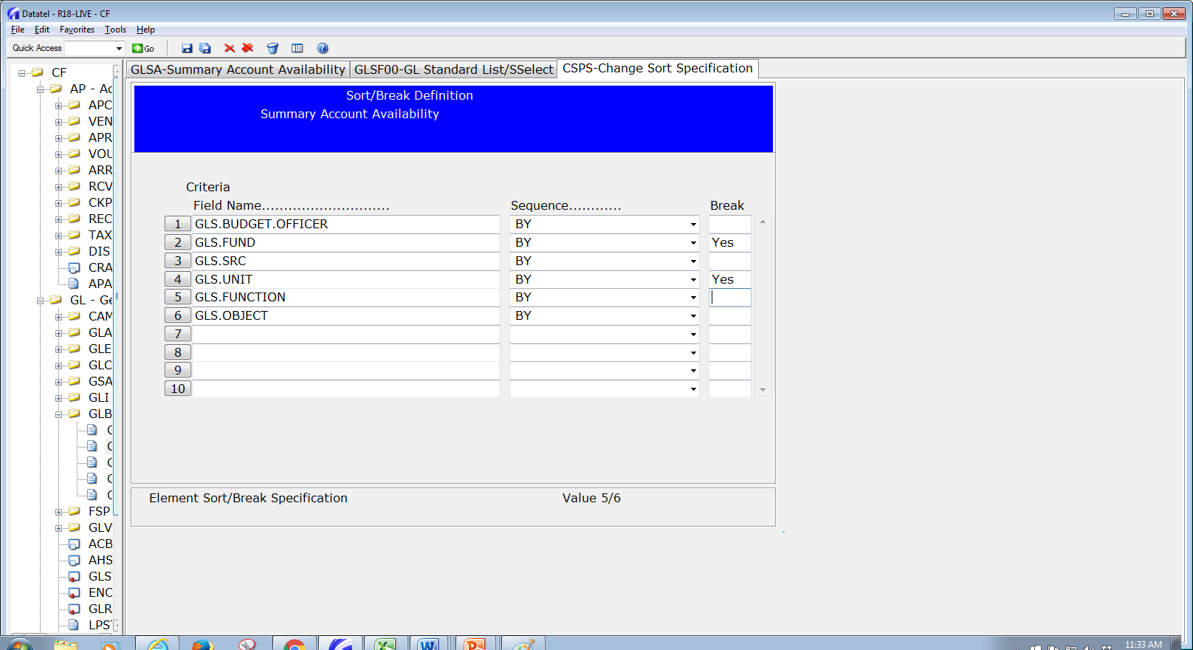

Slide 20
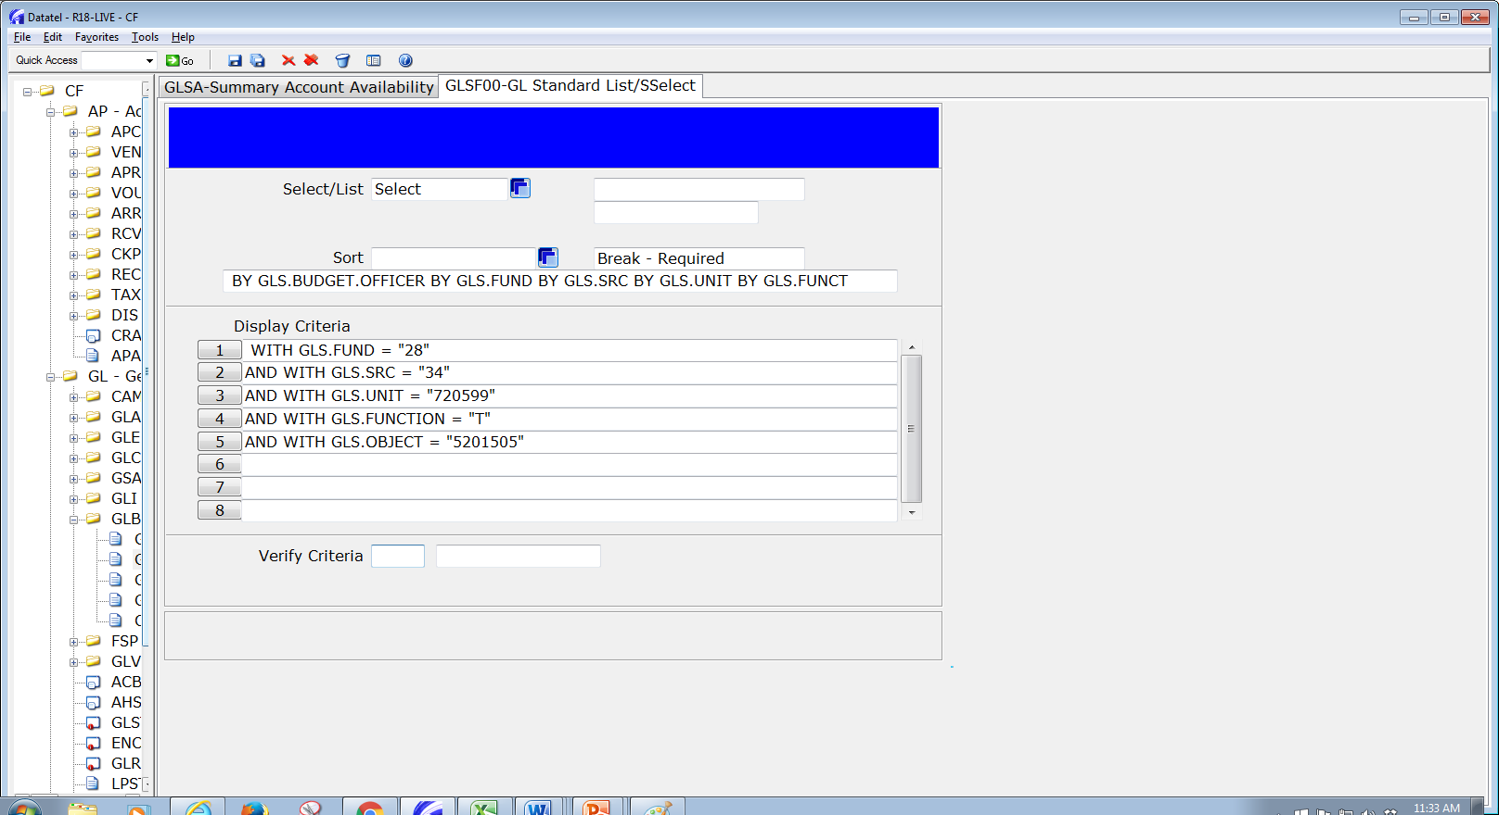

Slide 21
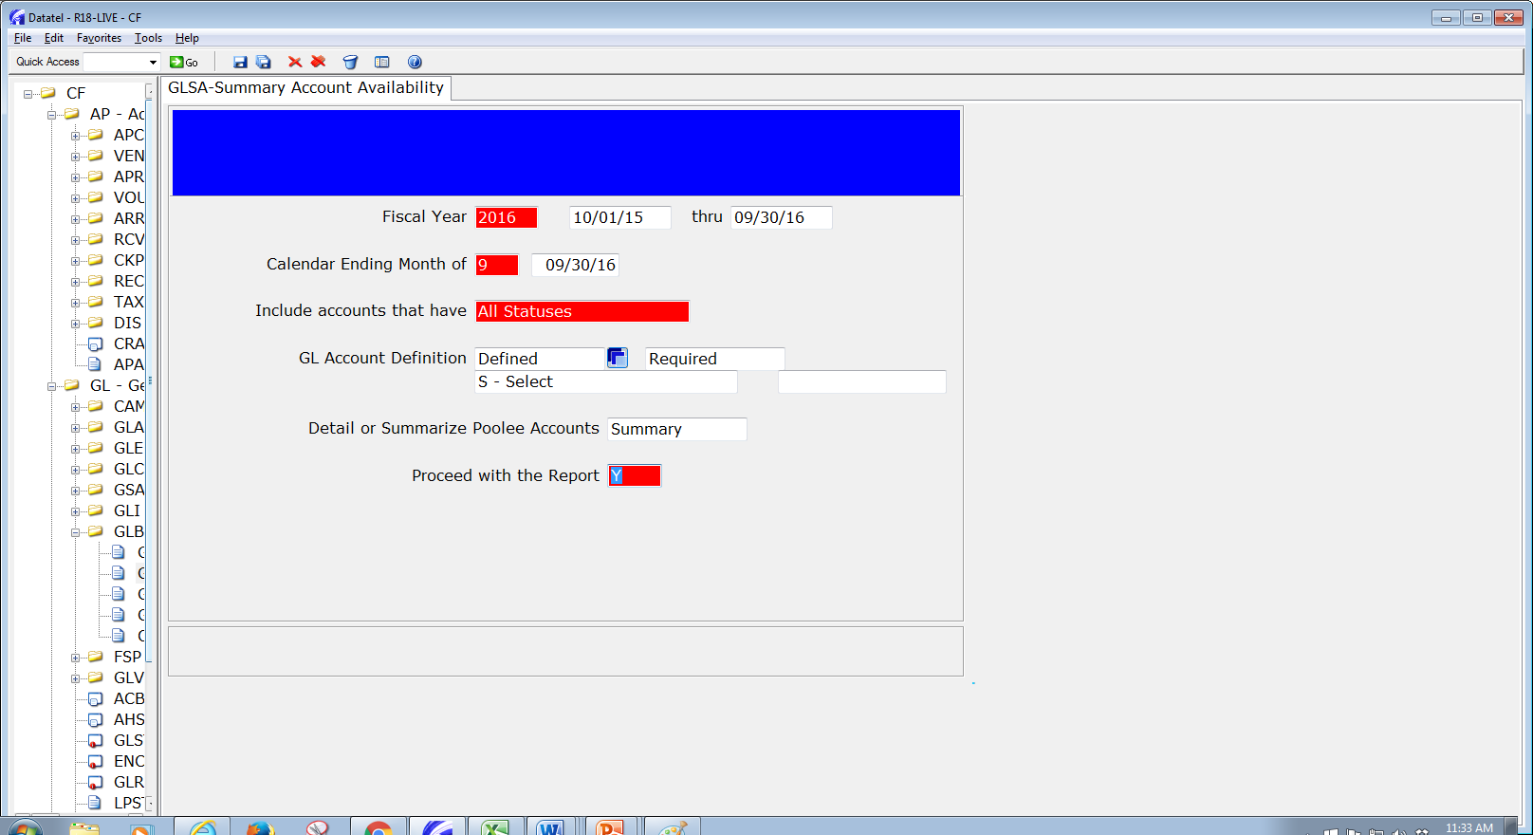

Slide 22
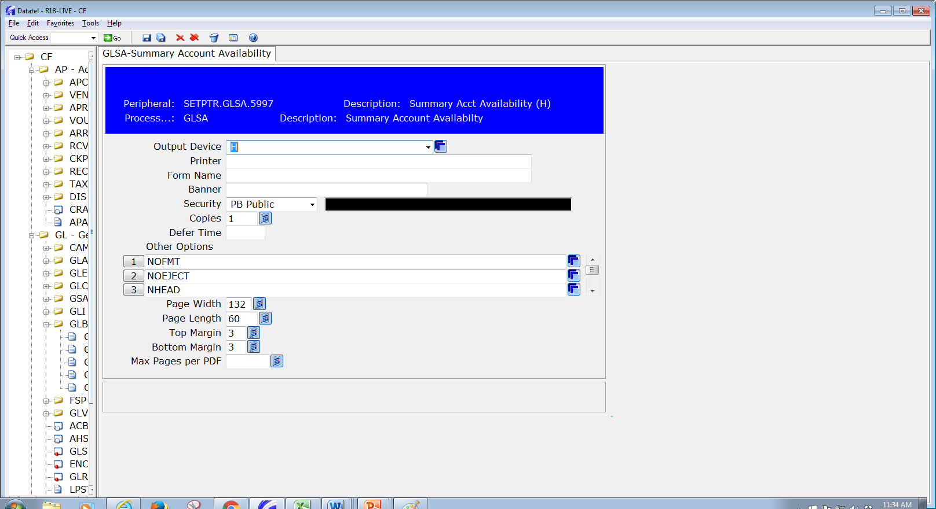

Slide 23
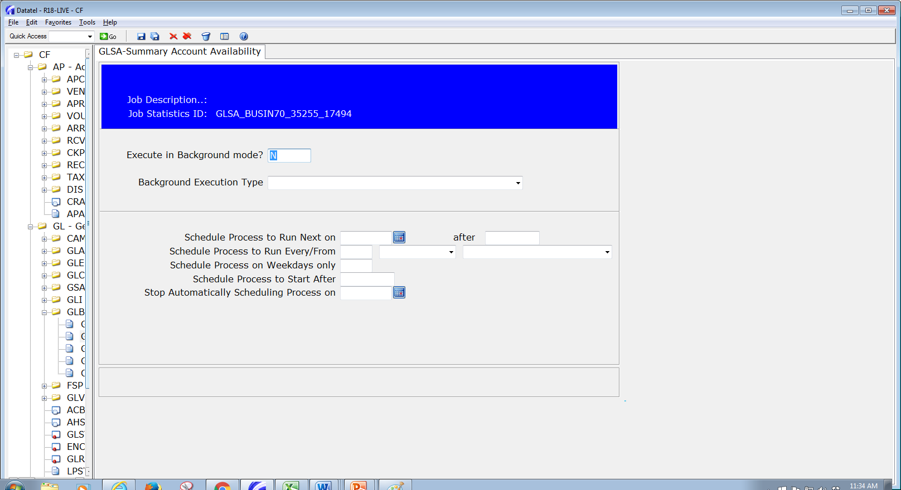

Slide 24
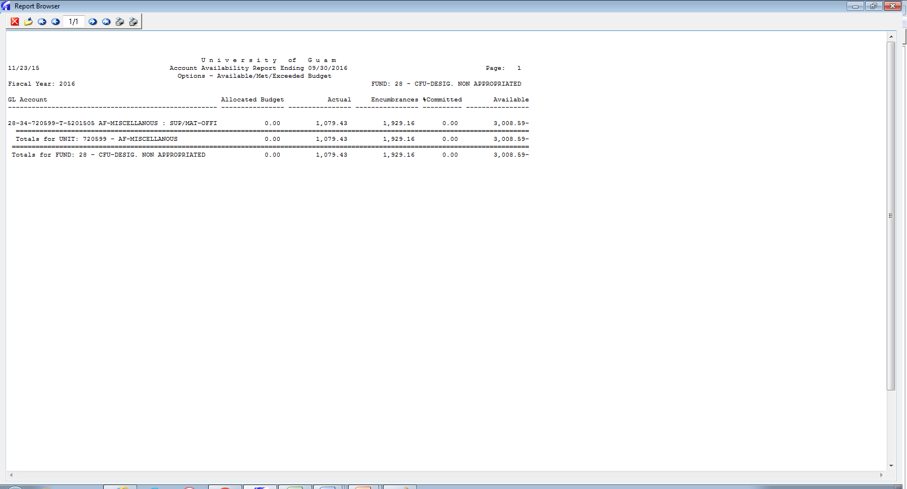

Slide 25


Slide 26
