Slide 1
Introduction to foliar fungi (and oomycetes) and fungal structures
Marin Talbot Brewer
Dept. Plant Pathology
University of Georgia
August 11, 2021
@marintalbrew
mtbrewer@uga.edu

Slide 2
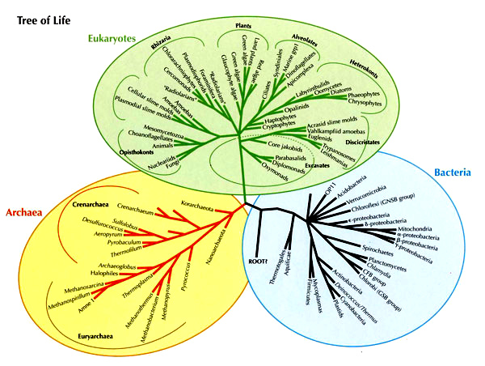
Fungi (and oomycetes) are eukaryotes
*
Membrane bound nucleus and organelles
*

Slide 3
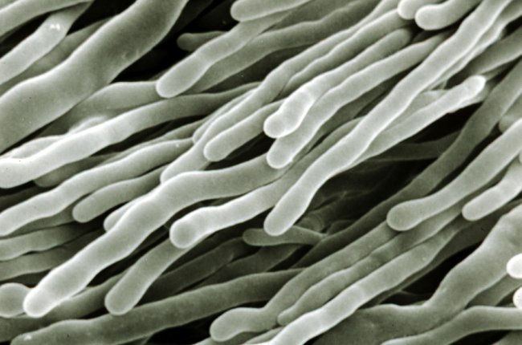
Hypha(e)
C. Mims

Slide 4
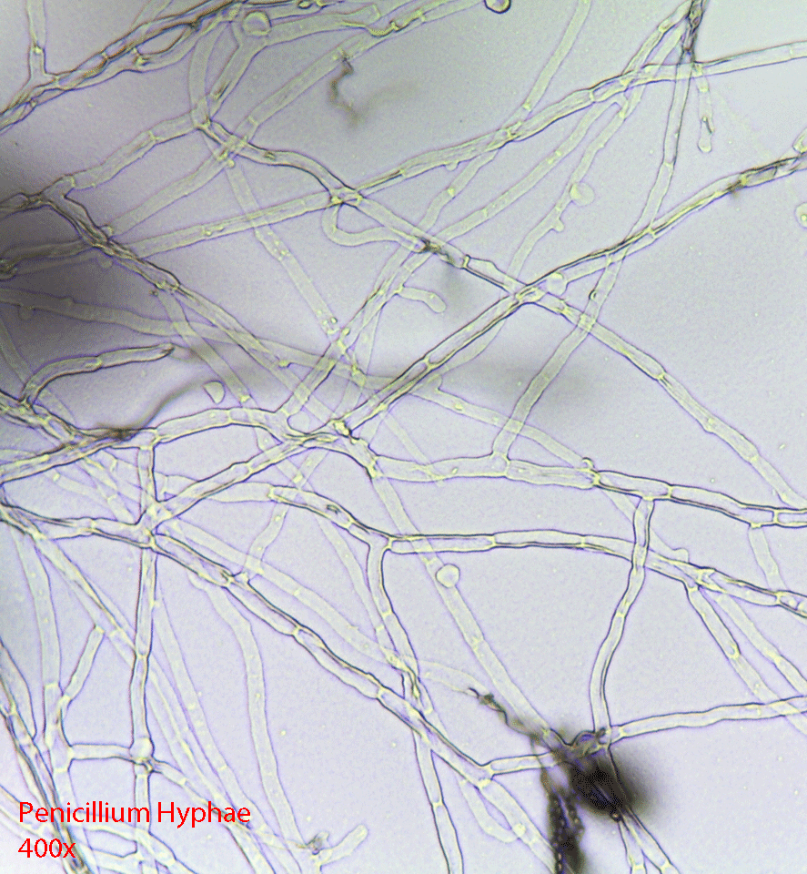
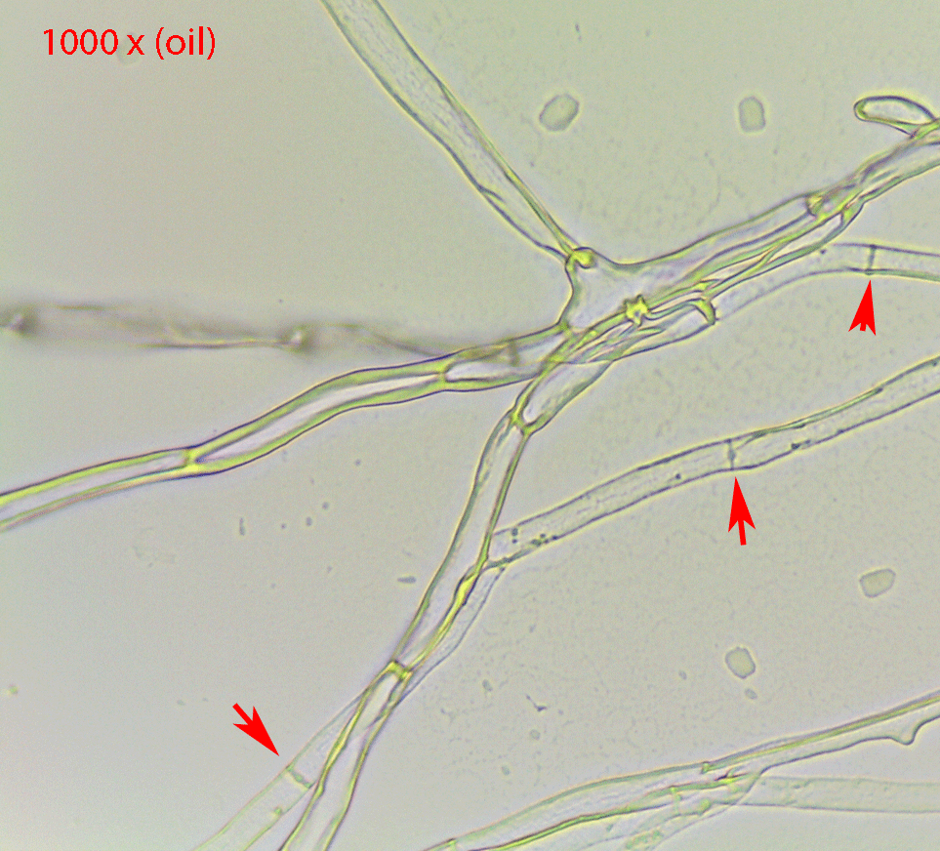
Hypha(e)

Slide 5
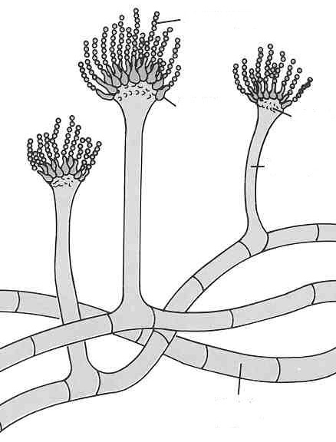
Hypha(e)
May be either septate or aseptate
septum (septa)

Slide 6
Septa

Slide 7
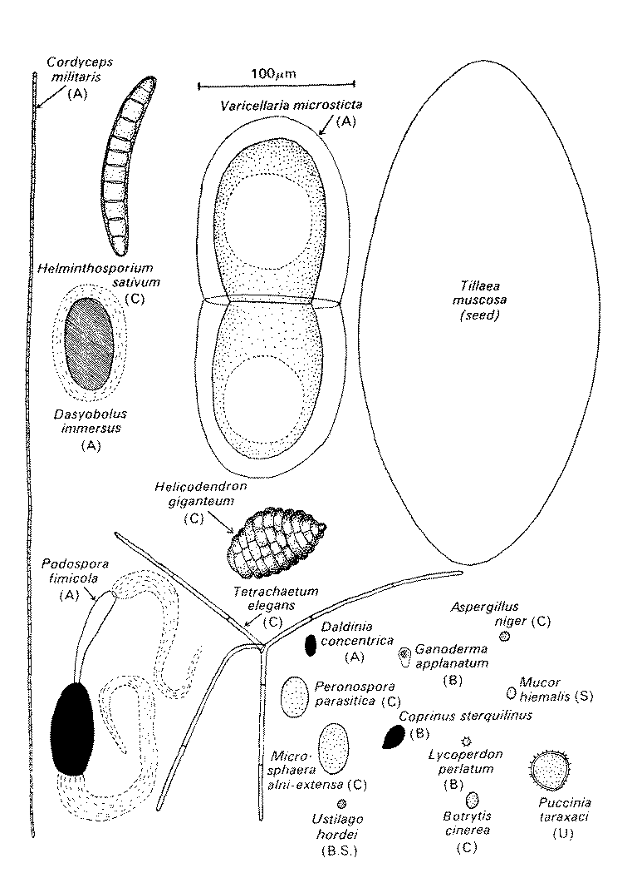
Reproduce by spores
sexual and asexual spores

Slide 8
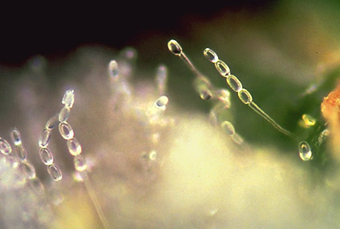
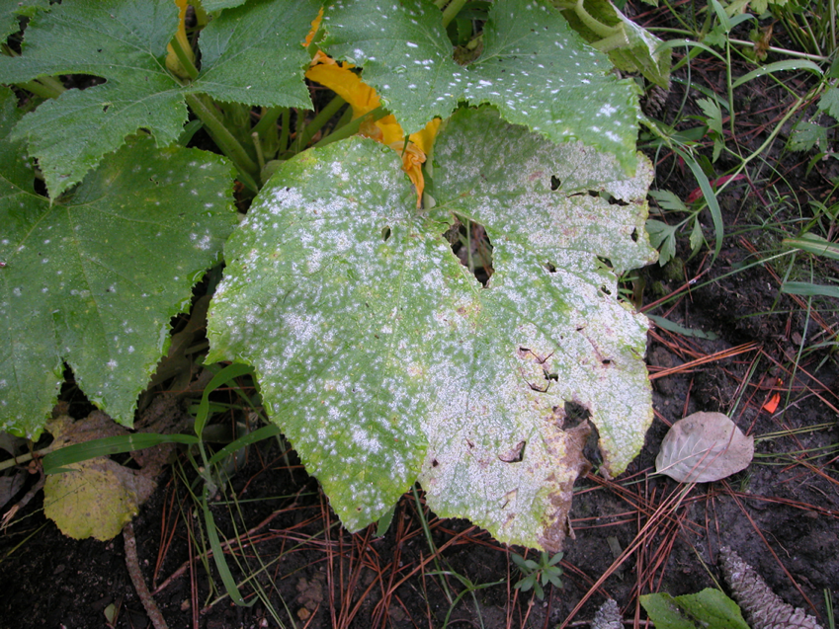
asexual spores

Slide 9
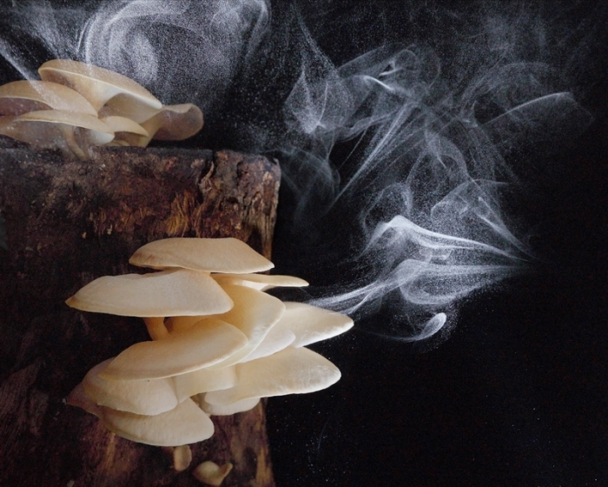
sexual spores

Slide 10
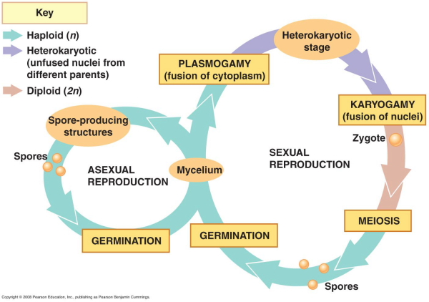
Fungal life cycle

Slide 11
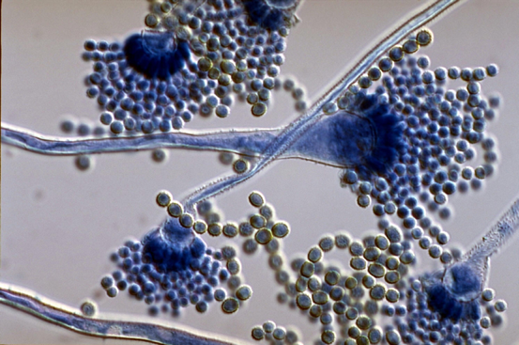
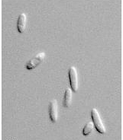
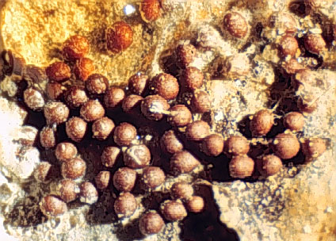
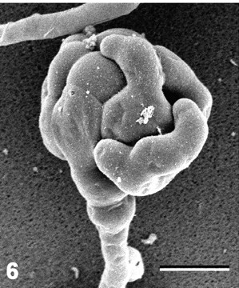
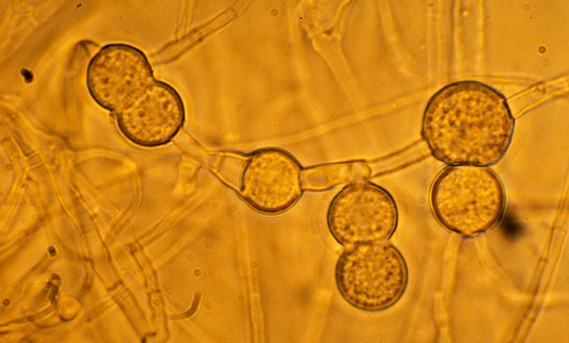
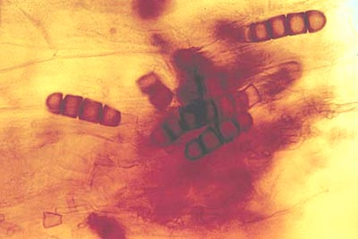
Types of asexual propagules
Conidia (-ium)
Chlamydospore
Sclerotia (-ium)

Slide 12
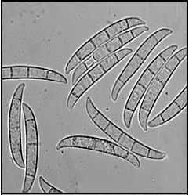
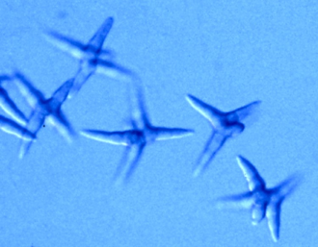
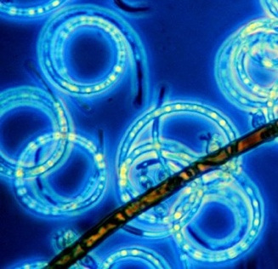
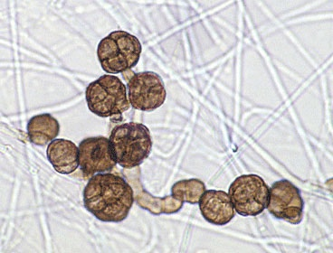
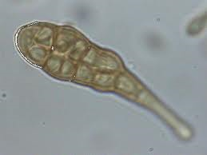
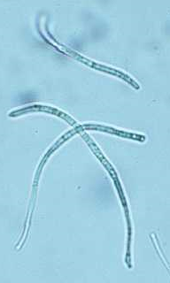
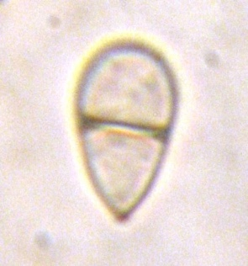
Spore Types
Color
Hyaline or bright (hyalo-)
Darkly pigmented (phaeo-)
Shape and septation
Single-celled
Two-celled
Multicelled
Brick-like
Thread-like
Helical Branched

Slide 13
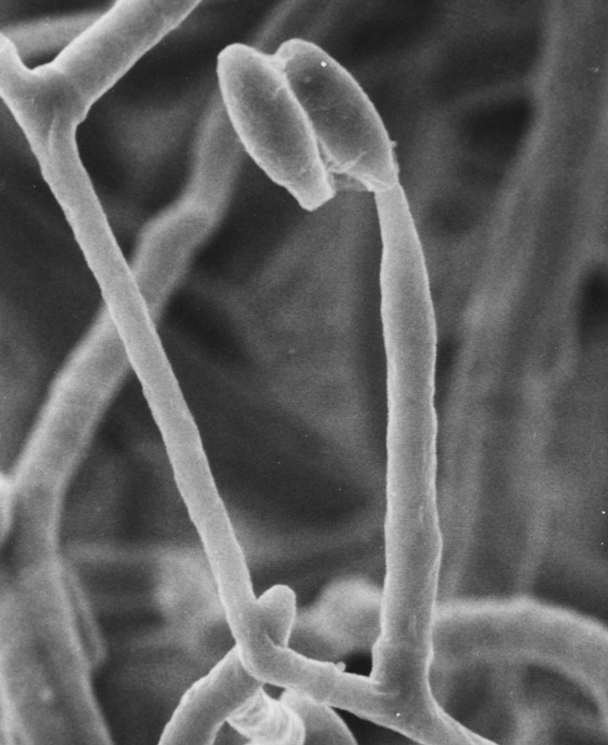
Conidiophores
Specialized hypha that bears conidia
Can be simple or complex

Slide 14
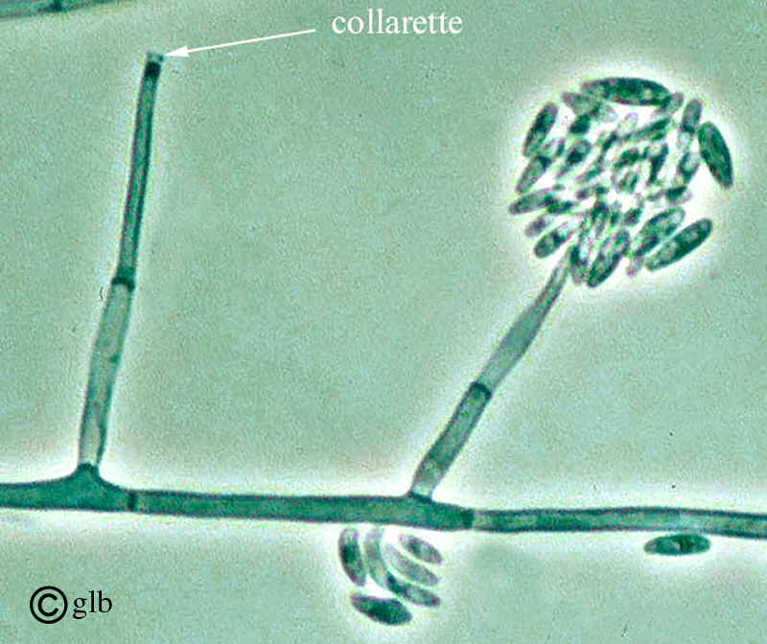
Fusarium
morphologically undifferentiated hypha bearing conidia-producing cells
phialides
conidiophores

Slide 15
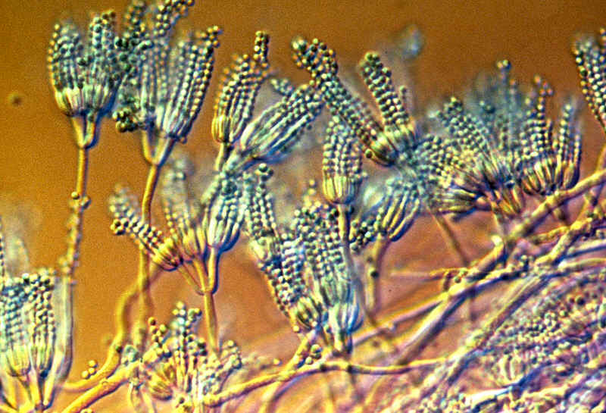
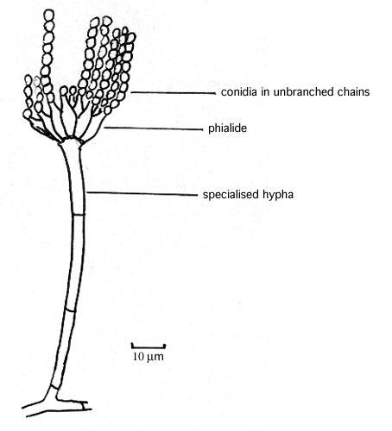
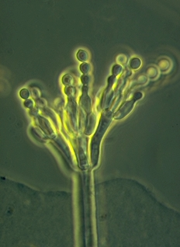
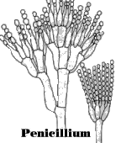
Penicillium
Example of complex conidiophores

Slide 16
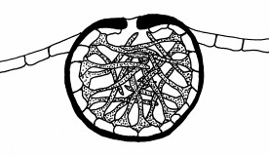
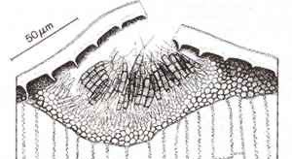
Conidia produced in enclosed structures (pycnidia or acervuli)
pycnidium (pl. pycnidia) - internal cavity lined with conidia-producing cells
acervulus (pl. acervuli) - a small, cushion-shaped structure erupting through the epidermis of plants

Slide 17
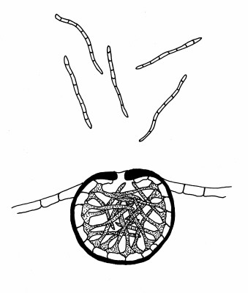
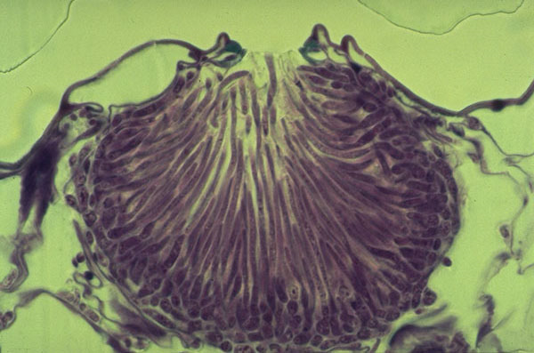
Pycnidia (-ium)

Slide 18
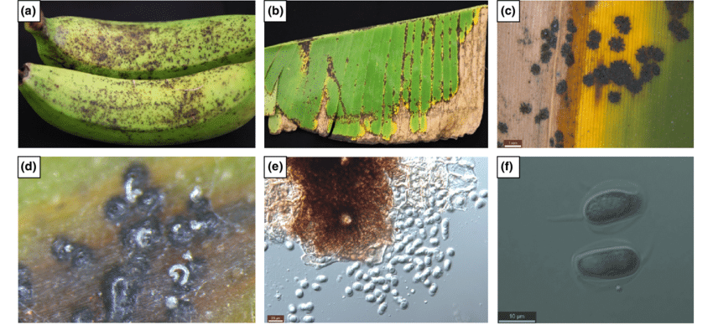
Pycnidia on banana

Slide 19
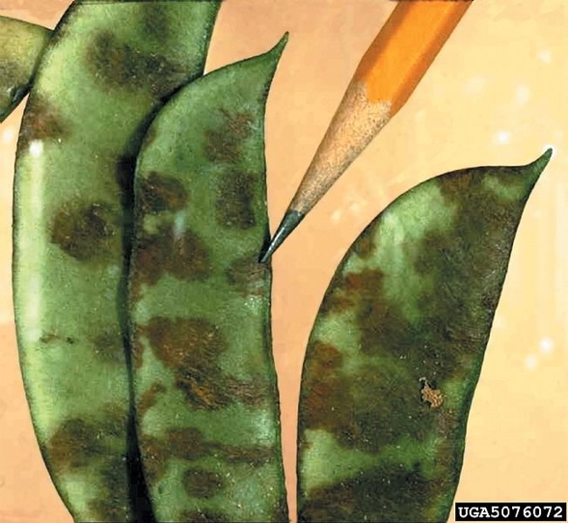
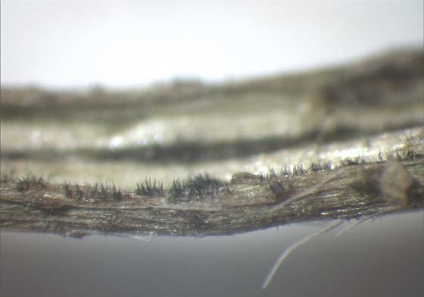
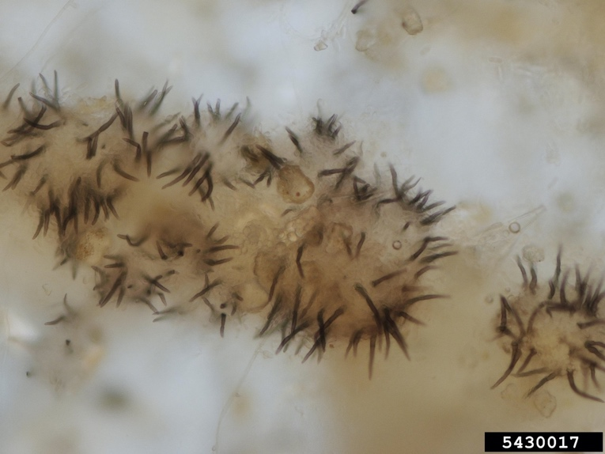
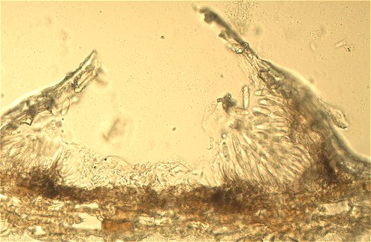
Acervuli (-us)

Slide 20
Fungal life cycle

Slide 21
Fungal Phyla

Slide 22
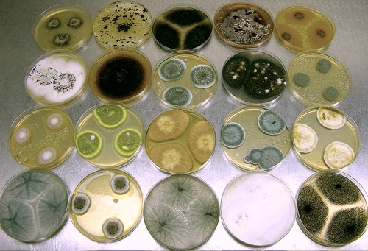
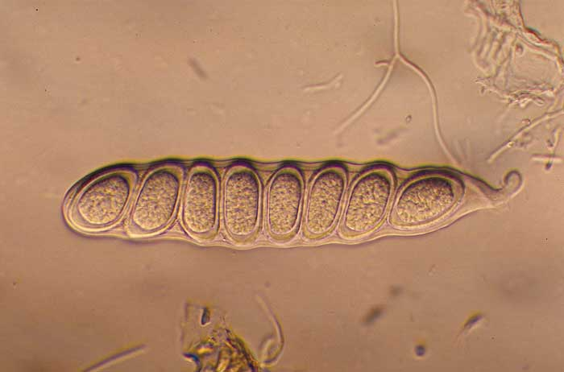
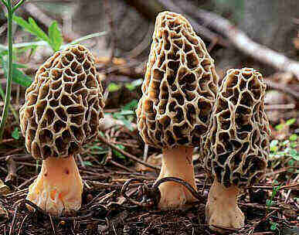
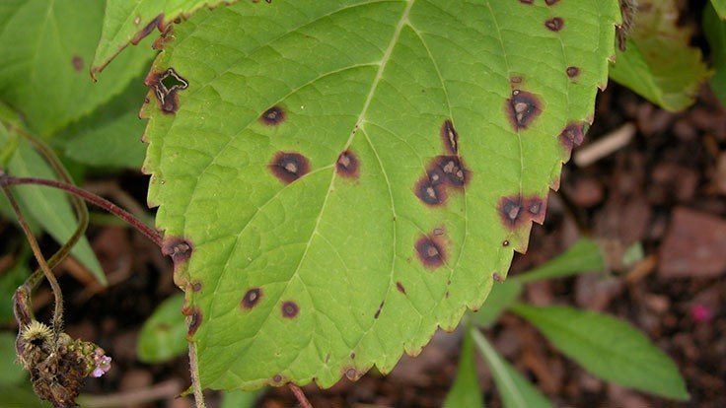
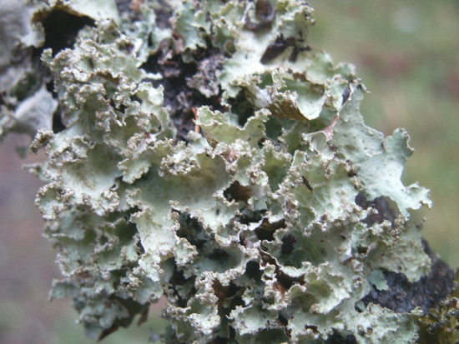
Ascomycota

Slide 23
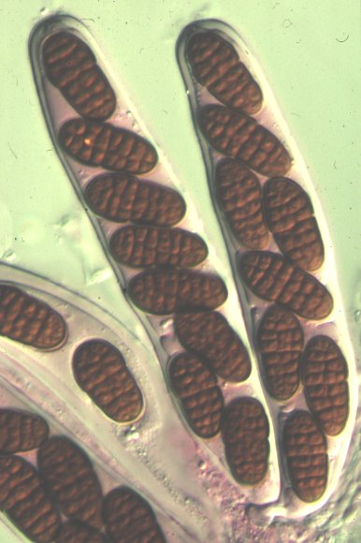
Ascomycota
ascospores in an ascus (pl. asci)

Slide 24
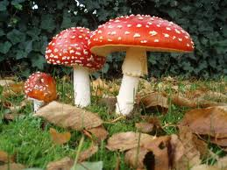
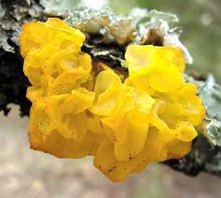
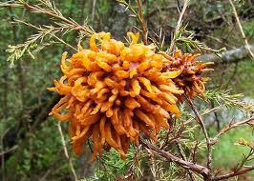
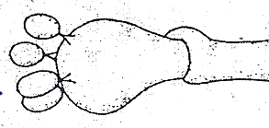
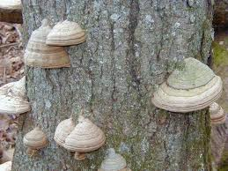
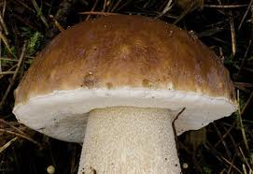
Basidiomycota
Basidiospores
Basidium

Slide 26
Basidium and basidiospores

Slide 27
Members of Ascomycota and Basidiomycota have regularly septate hyphae

Slide 28
Mucormycota “zygomycetes”

Slide 29
Leaf rot of pak choy Rhizopus oryzae

Slide 30
Many fungi have sexual and asexual stages
Teleomorph = sexual state
Nectria cinnabarina
Anamorph = asexual state
Tubercularia

Slide 31
Holomorphic View
Holomorph = Teleomorph + Anamorph
Nectria cinnabarina is a weak parasite of hardwood twigs and branches, often attacking through wounds. Early in the year, it produces the light-coloured anamorphic state of the fungus (Tubercularia), which is cushion shaped. Later in the year, clusters of dark orange perithecia (teleomorphic state) form.

Slide 32
Many fungi with sexual and asexual states: Powdery mildew
Sexual state (teleomorph)
= Erysiphe necator
Asexual state (anamorph)
= Oidium tuckeri
One fungus, one name!
One fungus, which name?

Slide 33
One fungus, which name????
Black sigatoka/black leaf streak of banana
Mycosphaerella fijiiensis
Pseudocercospora fijiensis

Slide 34
One fungus, one name
One fungus, which name????
US National Fungal Collections Fungal Database
https://nt.ars-grin.gov/fungaldatabases/

Slide 35
One fungus, which name????
Pseudocercospora fijiensis (syn. Mycosphaerella fijiensis)

Slide 36
Oomycota (not true Fungi)

Slide 37
Oomycetes share characteristics with fungi
Spores
Hyphae
Similar habitats and lifestyles
But, oomycetes are not fungi!
Not closely related based on DNA sequence
Kingdom Chromista ( or Stramenopila)
Produce motile, flagellated zoospores with 2 flagella
Different membrane and cell wall components
Different metabolic pathways and organelle structure
Diploid (2N) nuclei in hyphal phase

