Slide 1
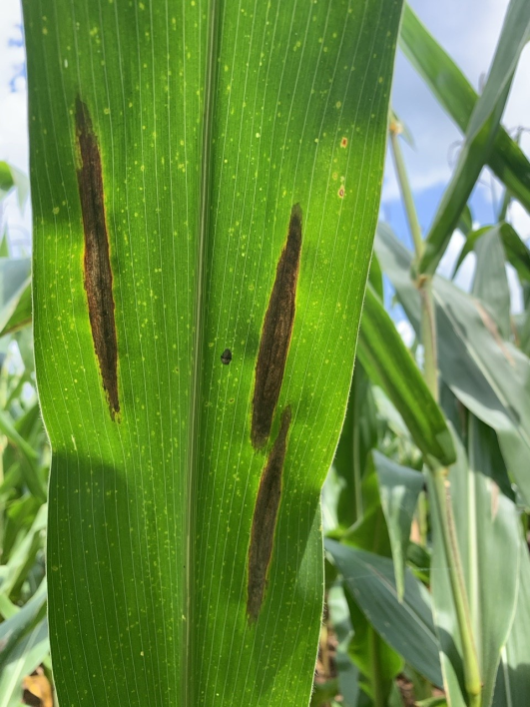
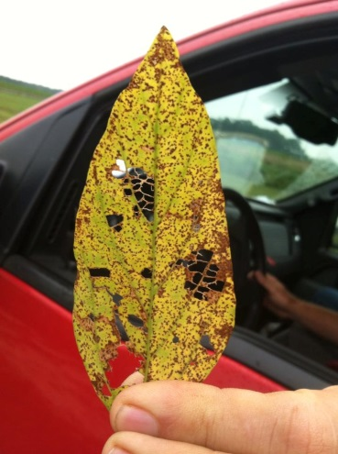
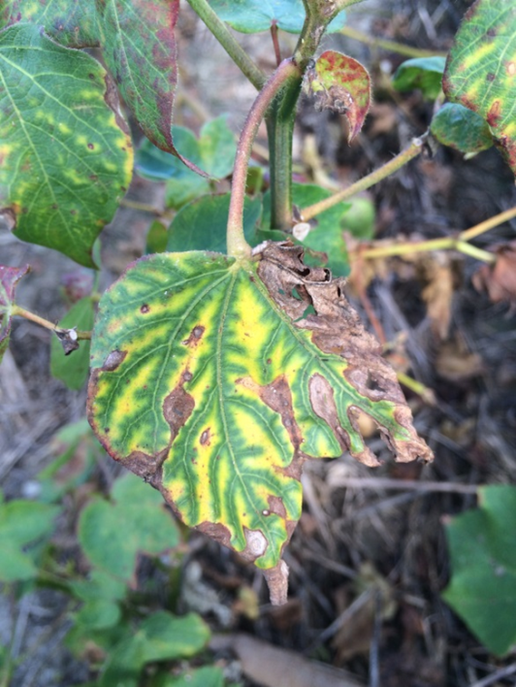
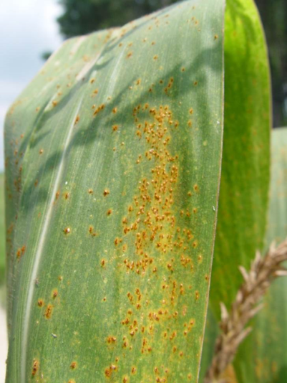



Training for Agricultural Professionals in Guam and the Northern Mariana Islands on identification of prevalent fungal leaf pathogens and their diseases
Robert C. Kemerait Jr., PhD
Professor and Extension Specialist
Department of Plant Pathology
University of Georgia CAES
Follow on Twitter “bob kemerait”

Slide 2
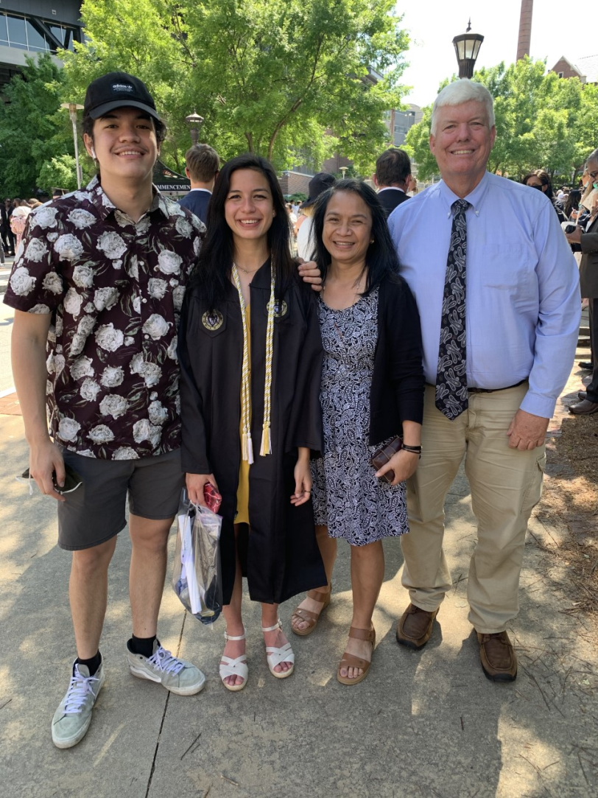
About Me
Professor and Extension Specialist, Department of Plant Pathology, UGA
Disease and nematode control for peanuts, corn, cotton and soybeans.
Determining best management strategies for emerging diseases, e.g., target spot, blue disease, areolate mildew and bacterial blight.
Collaborative work with research colleagues and training graduate students.
Work with county agents for field trials, training, and disease and nematode management support.
International work in developing countries.
Son Jimmy, daughter Perrine, bride Pam

Slide 3
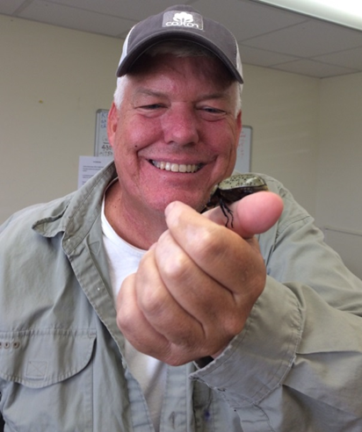

Objectives Throughout My Talks
To facilitate your understanding of basic topics associated with diagnosis of plant diseases caused by fungal pathogens.
To share from my experiences as an Extension plant pathologist to foster discussion and questions.
To learn from you and your experiences working in the Northern Mariana Islands.

Slide 4
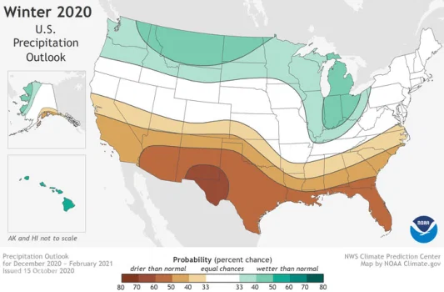
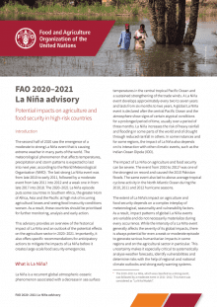
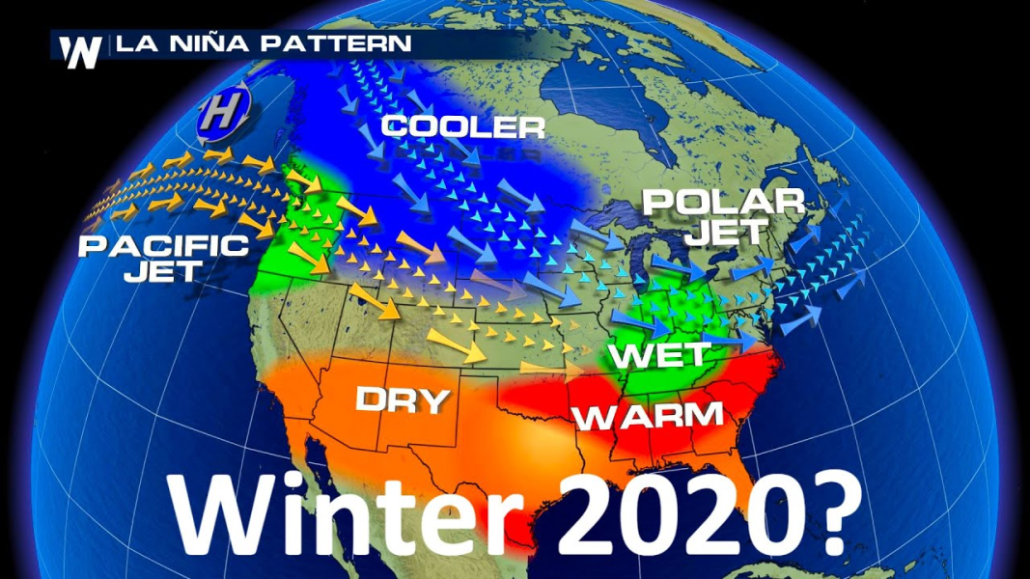

Climate, Agriculture, and Extension beatings will continue until morale improves

Slide 5
Foliar pathogens, endophytes, and saprophytes: symptoms caused by foliar pathogens
Robert C. Kemerait Jr., PhD
Professor and Extension Specialist
Department of Plant Pathology
University of Georgia CAES
Follow on Twitter “bob kemerait”

Slide 6
Endophytes and why they matter
An endophyte is an endosymbiont.
Often a bacterium or a fungus.
Lives with a plant for at least part of its life cycle.
Endophytes are ubiquitous and found in a vast number of species of plants.
Most endophyte/plant relationships are not well-understood.
  Endophytes may enhance plant growth.
  May enhance nutrient acquisition.
  Improve the plant’s ability to tolerate abiotic stresses such as drought and salinity.

Slide 7
Saprophytes and why they matter
Saprophytic fungi are usually found associated with decaying vegetation throughout the environment.
Saprophytes play a critical ecological role in recycling nutrients in the environment.
Because of their prevalence, they may be confused with parasitic fungi.

Slide 8
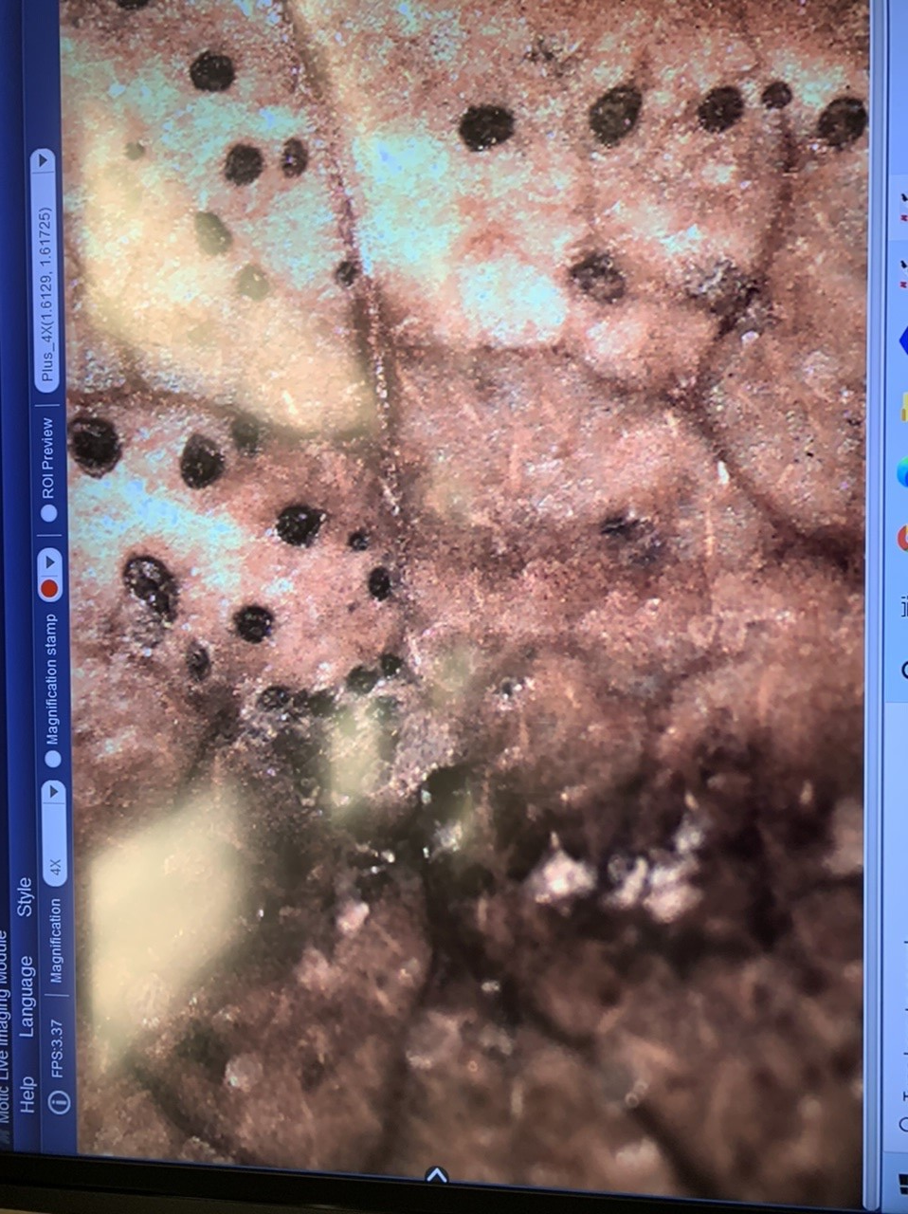
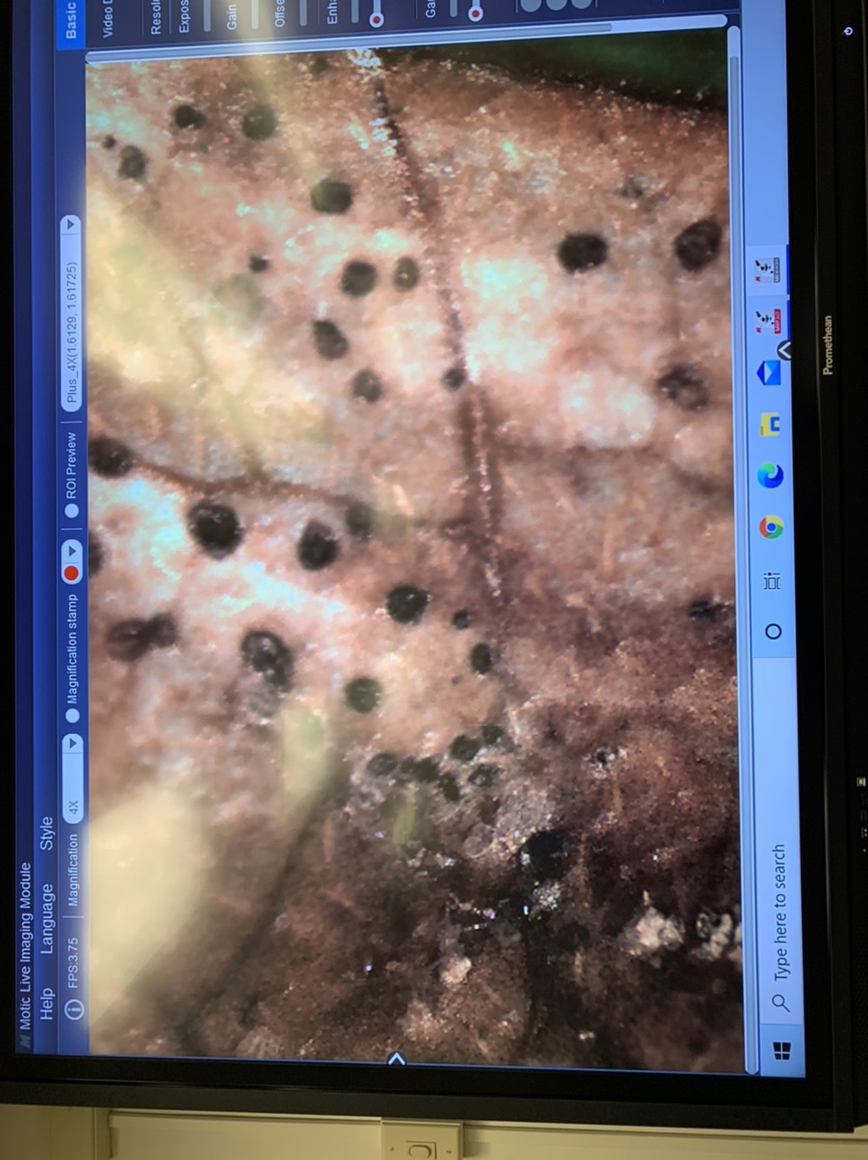
The Trouble With Saprophytes and Diagnostics

Slide 9
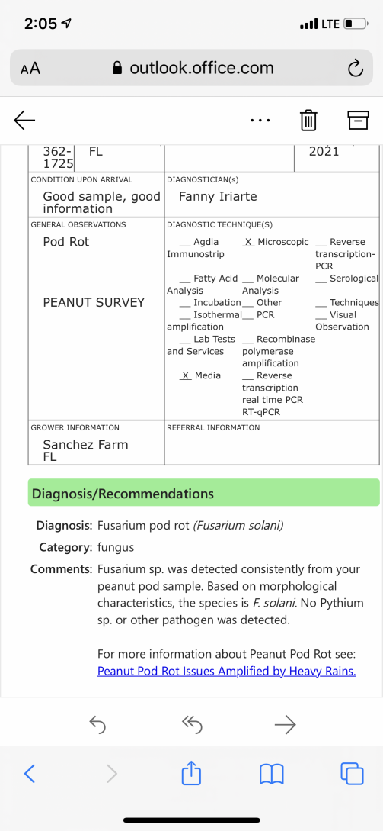
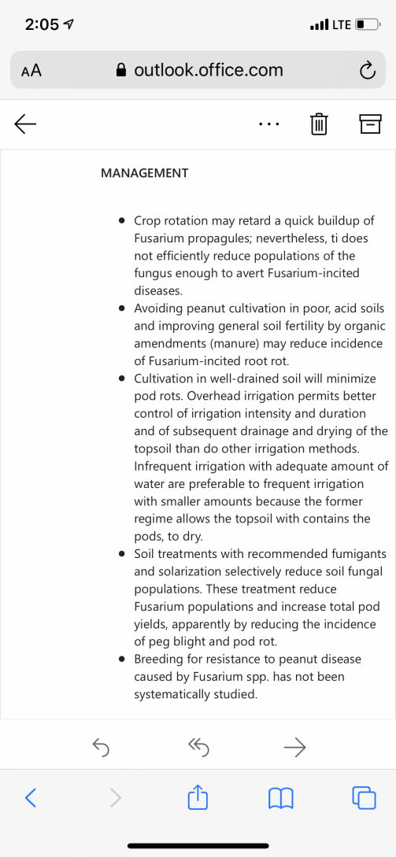
The Trouble with Saprophytes

Slide 10
Not the Problem……
ONE OF THE MOST DIFFICULT aspects of disease diagnosis is that MUCH of what you will find under the microscope is NOT the problem!
  Pine pollen.
  Plant parts (trichomes, chloroplasts, etc.)
  Fungal “parts” (like conidiophores) that we cannot diagnose…
  Spores from other non-pathogenic fungi.
  Spores from other WEAKLY pathogenic fungi, that WILL fool you sometimes!
    ALTERNARIA!

Slide 11
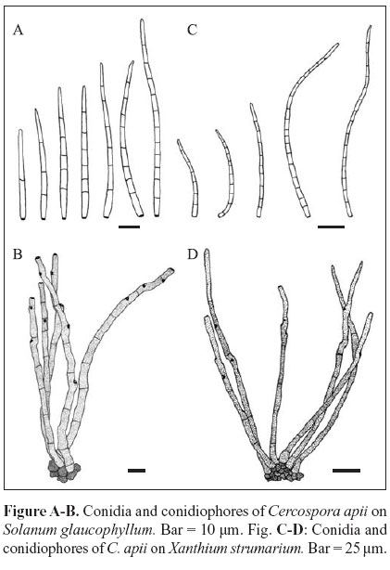
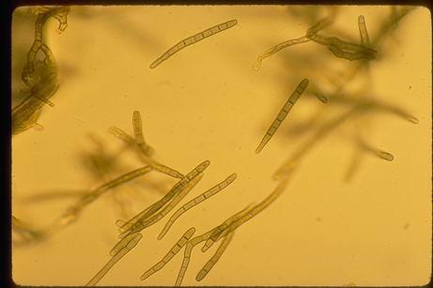
Cercospora with condiaphores

Slide 12
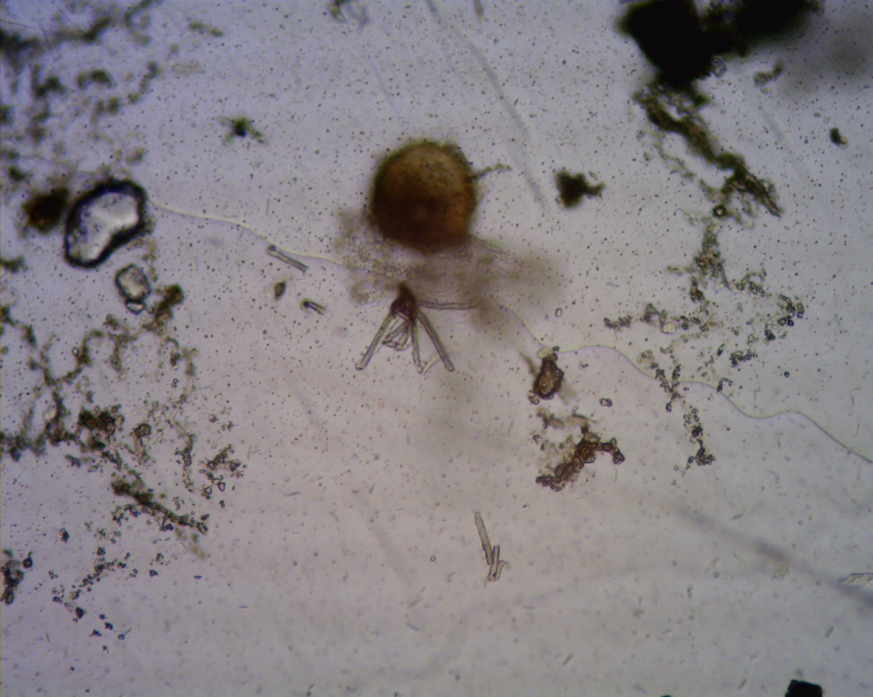
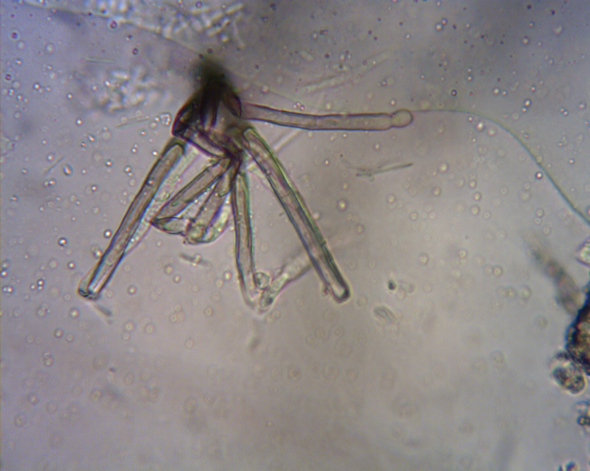
Conidiaphores not diagnostic of the pathogen…......

Slide 13
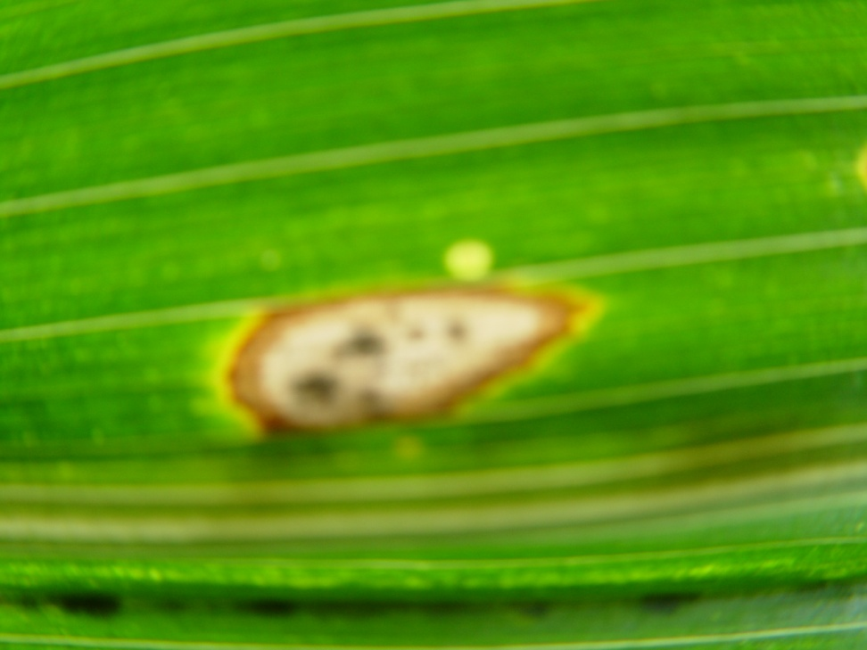
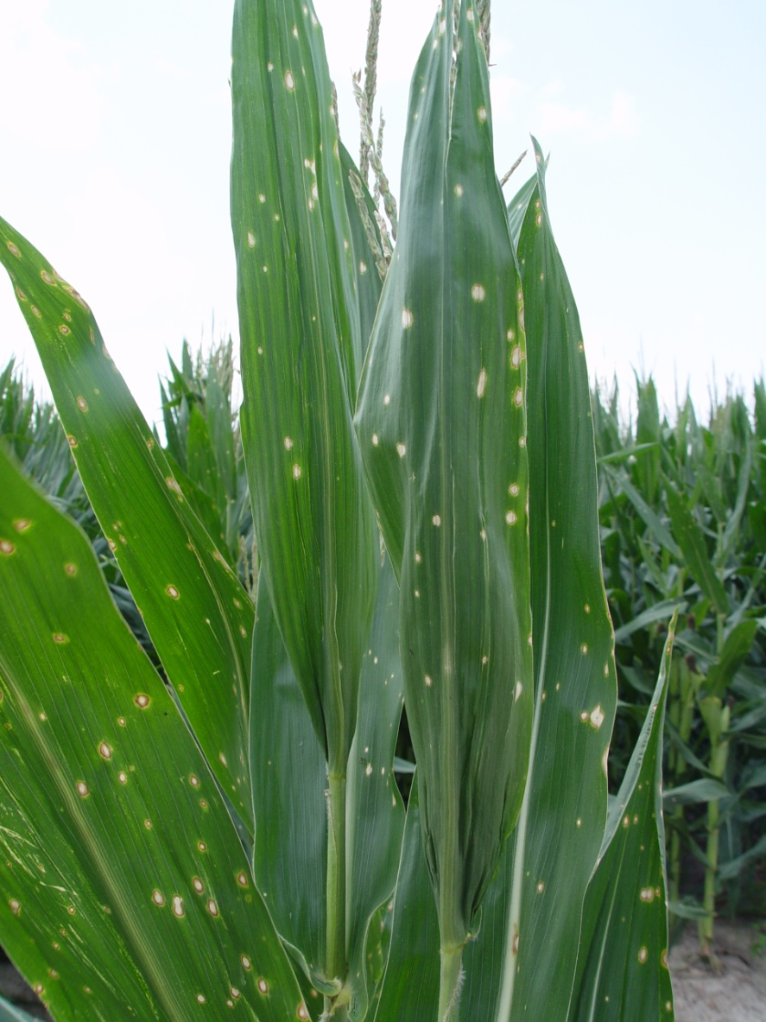

Slide 14
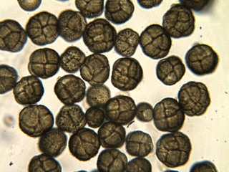
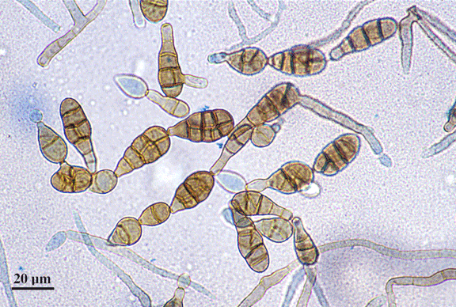
Alternaria and Epicoccum spores that are commonly observed on row crops but that are typically NOT the problem
Epicoccum is especially common on corn

Slide 15
Fungal Pathogens, Sign, and Symptoms
In plant disease diagnosis what are “signs and symptoms”?
Symptoms of disease: the effects of a specific disease on a specific host.
Signs of disease: actual parts of the pathogen, like spores, that when observed can lead to an accurate diagnosis.
Plant disease diagnosis is the process by which a disease and/or pathogen is identified.

Slide 16
What is it??
Symptoms versus Signs
Symptoms: visible expression by the PLANT of the effects of a disease or nematode.
  Stunting (e.g. Tomato spotted wilt of peanut; nematode damage)
  Leaf spots
  Wilts
  Interveinal chlorosis (viruses, sometimes nematodes)
  Root-galling (root-knot nematode damage)
Signs: Actual structures associated with the pathogen that causes the plant disease.
  Sclerotia, sporulation/spores, fungal growth, etc.

Slide 17
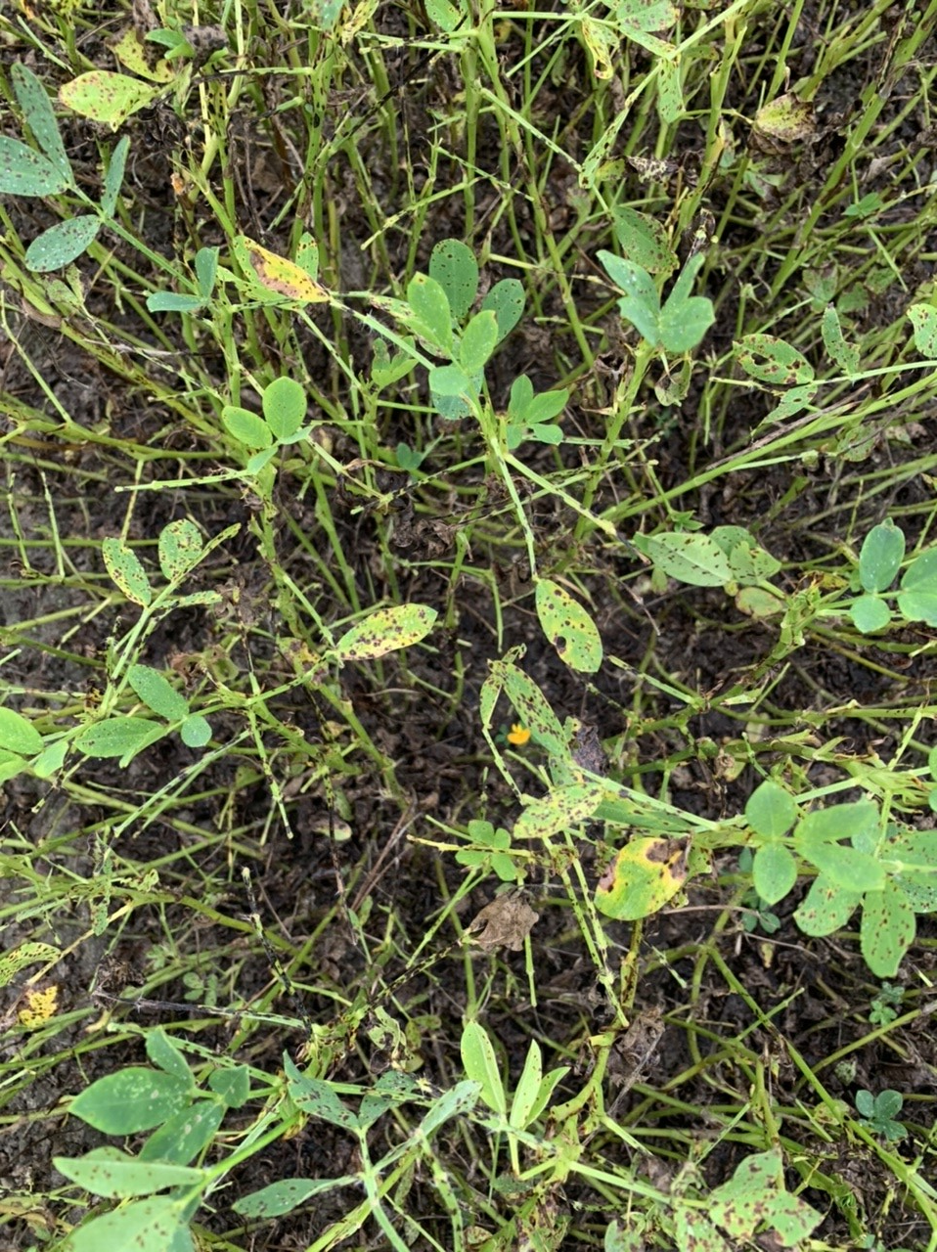
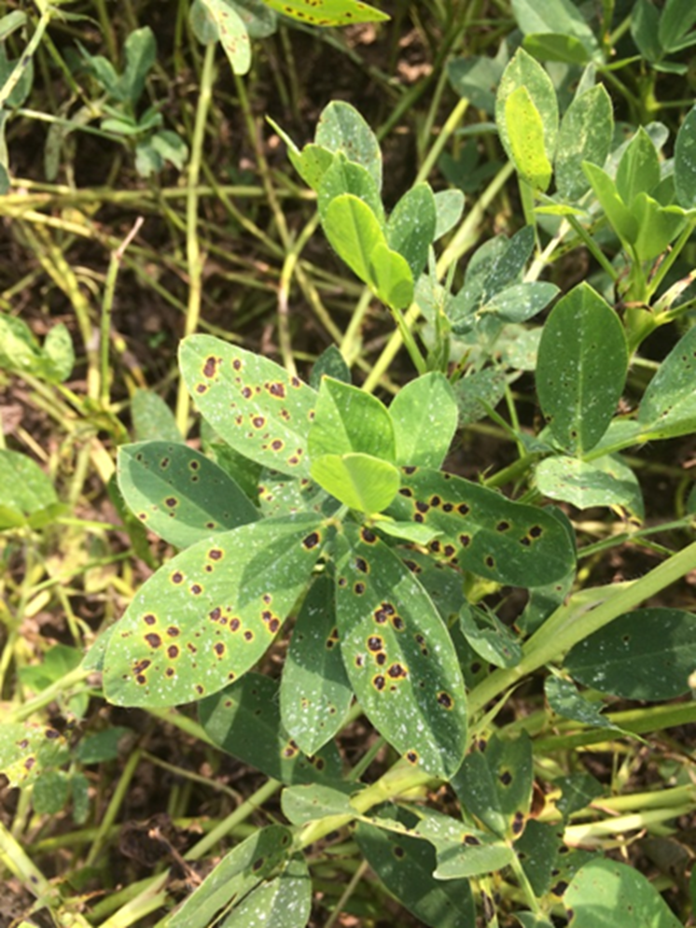
Late Leaf Spot

Slide 18
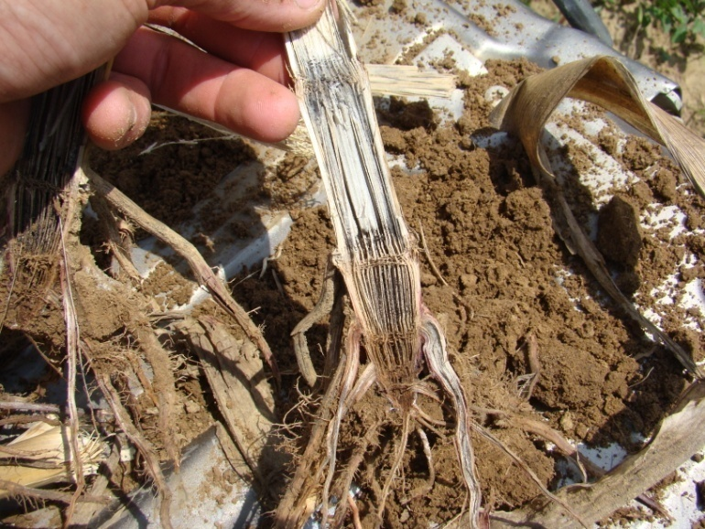
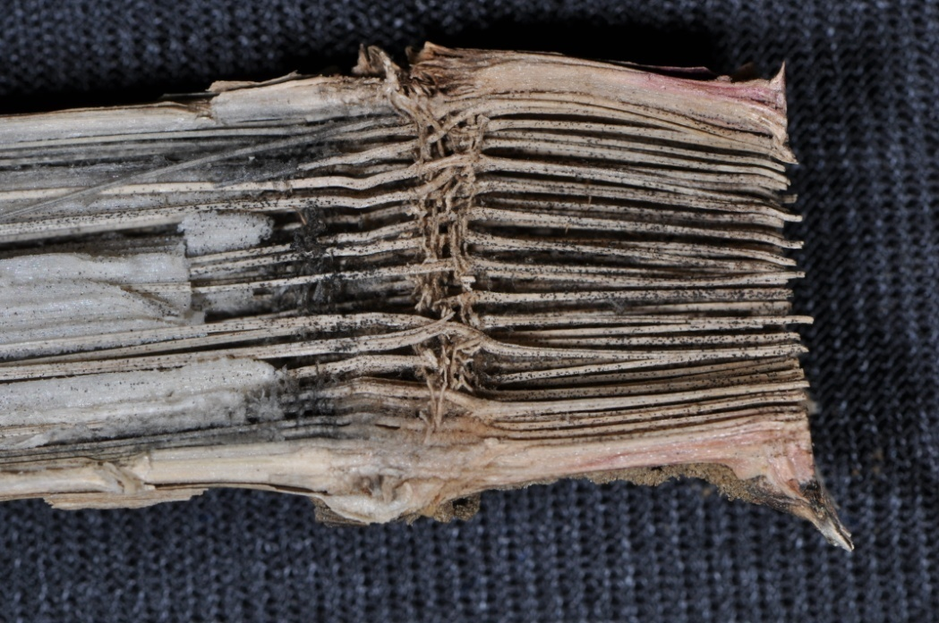
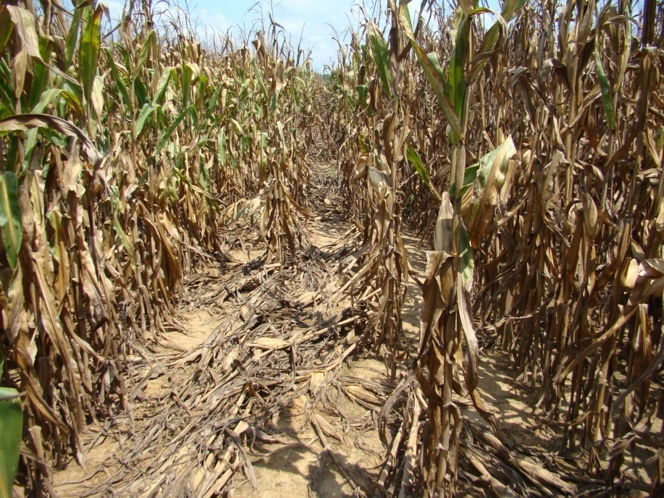
Charcoal Rot:
Macrophomina phaseolina
Not often seen in GA.
In 2011 found scattered across state.
Relate to stress on crop.
Jason Brock and Jeremy Kichler, UGA Coop. Ext..

Slide 19
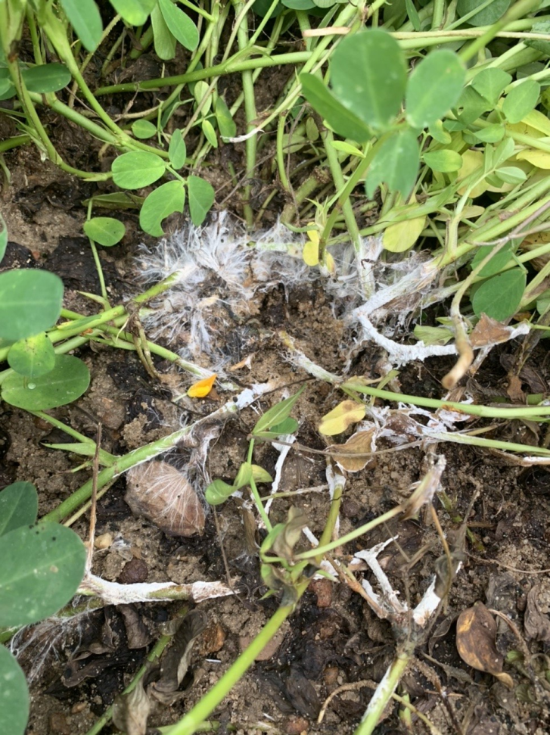
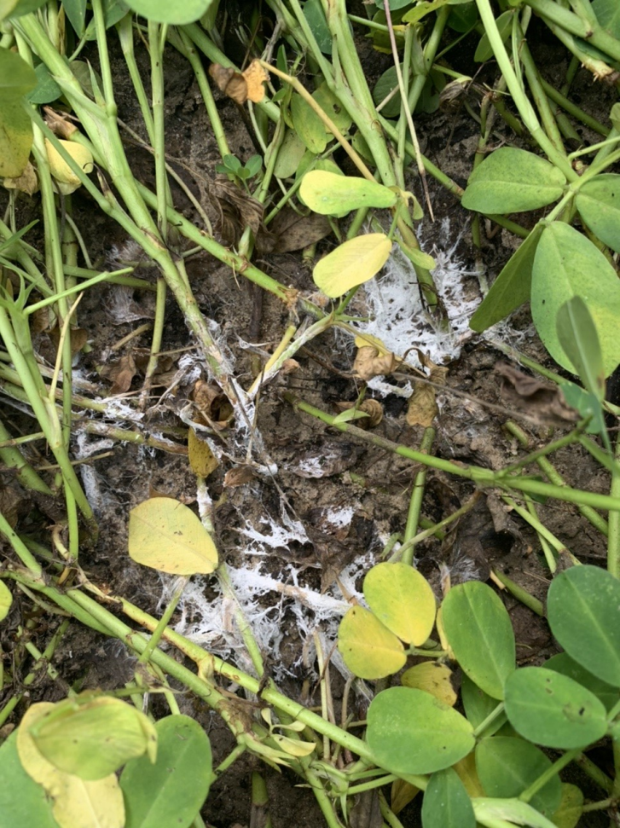
Southern Stem Rot

Slide 20
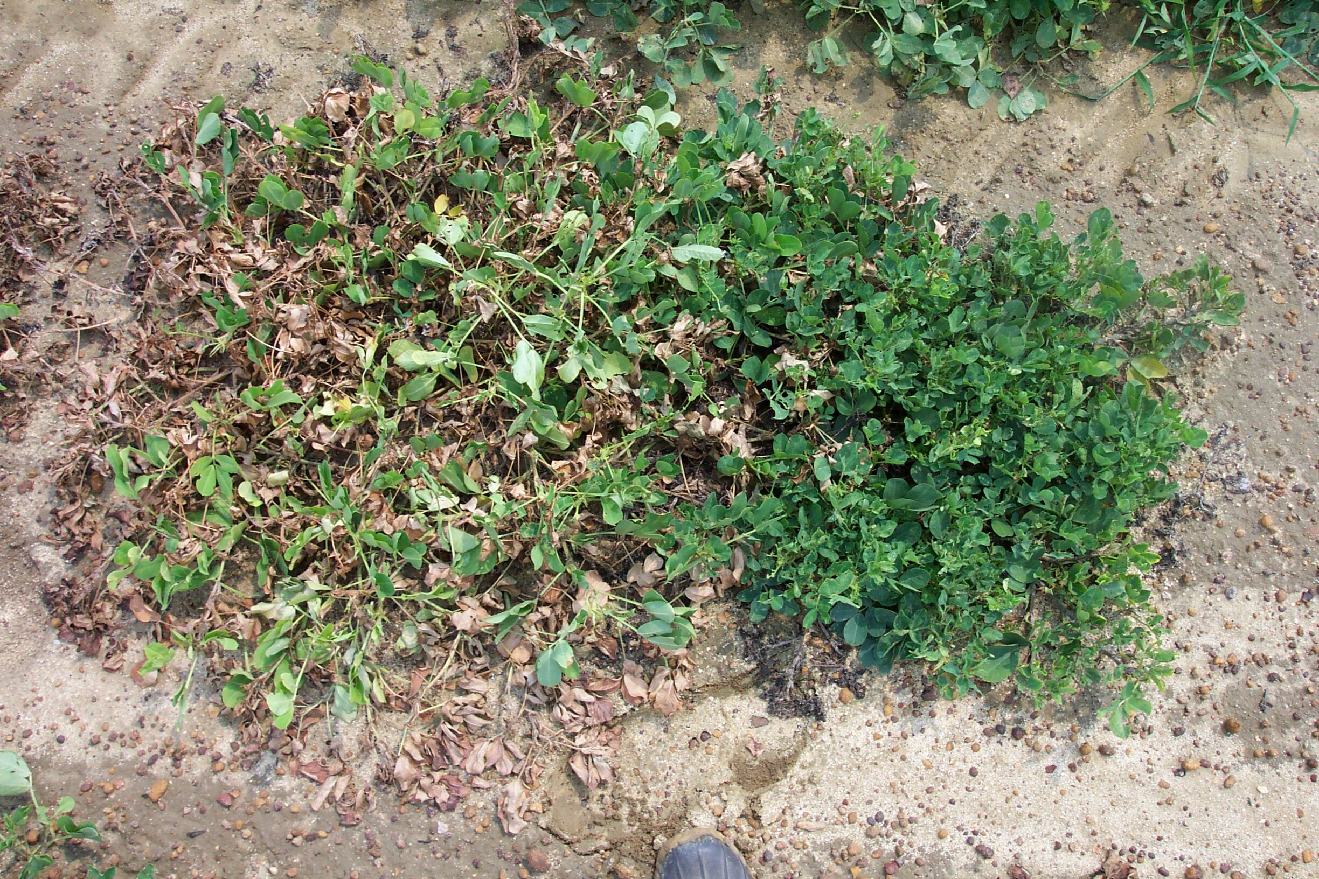
Tomato Spotted Wilt Virus

Slide 21
Important Symptoms of Plant Diseases and Nematodes
Stunting- e.g. nematodes, some viruses
  Confused with poor soil fertility, hard-pan, chemical injury, etc.
Leaf spots- caused by many fungal and bacterial pathogens
  Confused with chemical burns, spray drift, Funky leaf spot, etc.
Leaf necrosis- can be associated with a number of fungal pathogens, advanced disease
Galls- when found on roots, caused by root-knot nematodes
  Can be confused with rhizobium nodules on peanuts and soybeans
Shredded stem tissue- commonly associated with stem rot (white mold) and Aspergillus crown rot on peanut.
Interveinal chlorosis- often with viral diseases and also with vascular wilt diseases.
  Confused with nutrient deficiencies, herbicide injury, etc.
Die-back- expressed in foliage and stems, but actually a result of damaged root-system or vascular system!!!

Slide 22
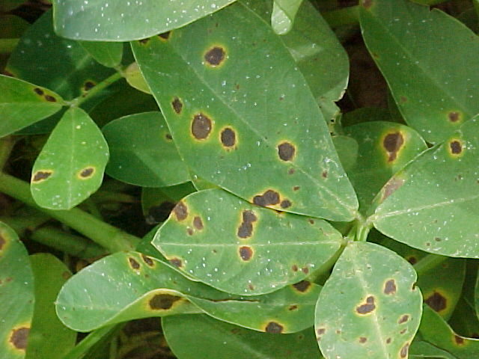
Early Leaf Spot

Slide 23
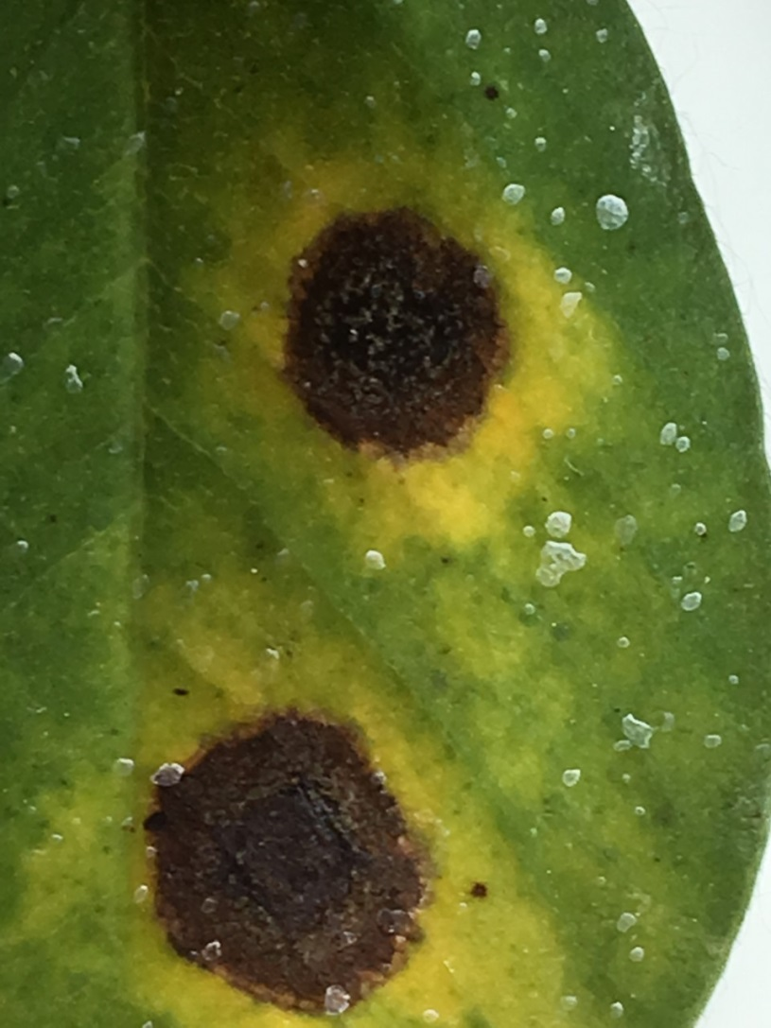

Early and Late Leaf Spot Diseases

Slide 24
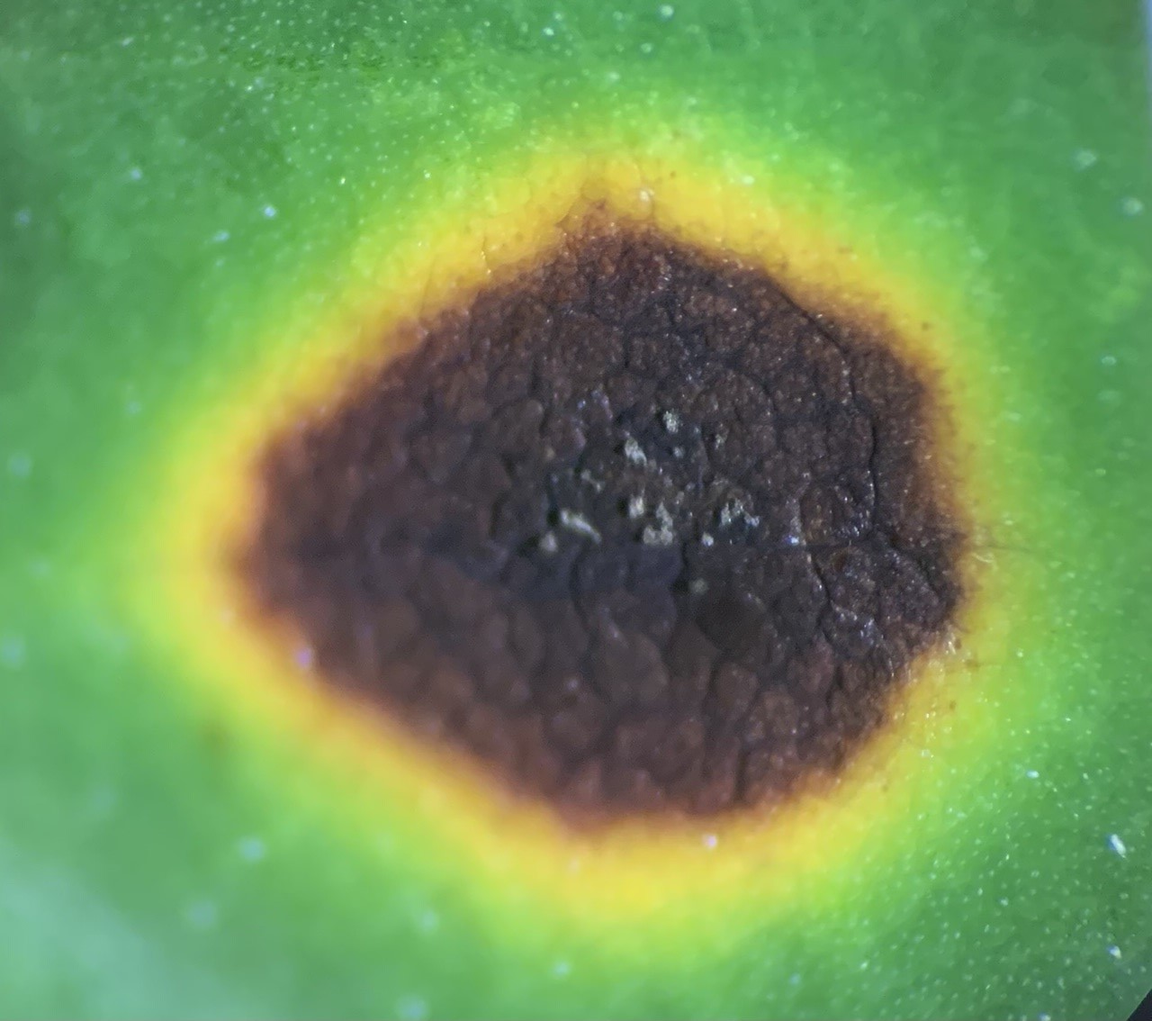
Early Leaf Spot

Slide 25
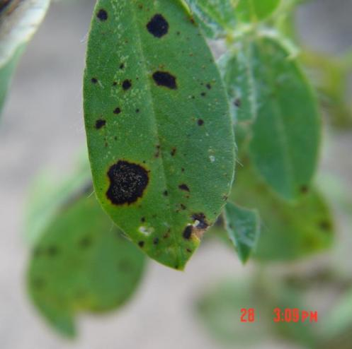
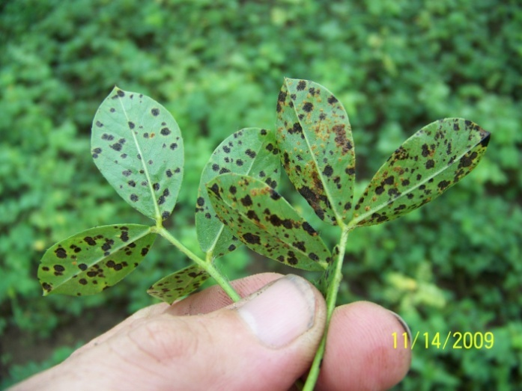
Leaf spot diseases of peanut

Slide 26
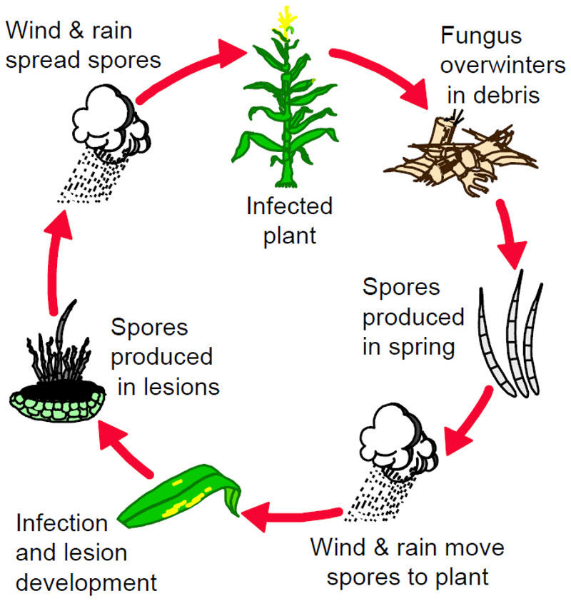

Slide 27
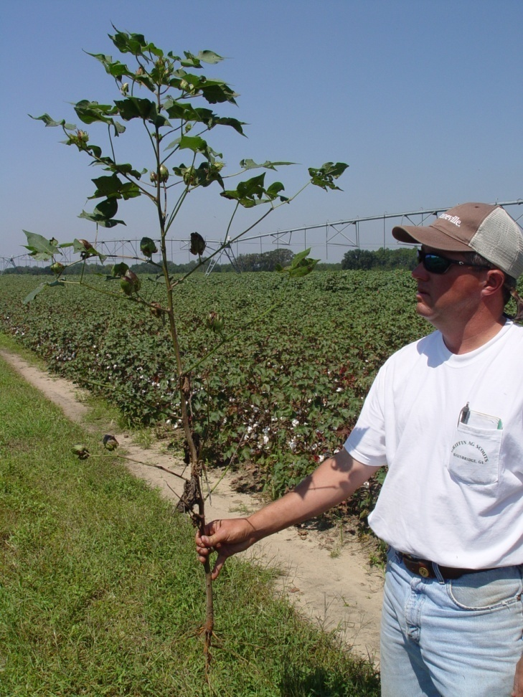
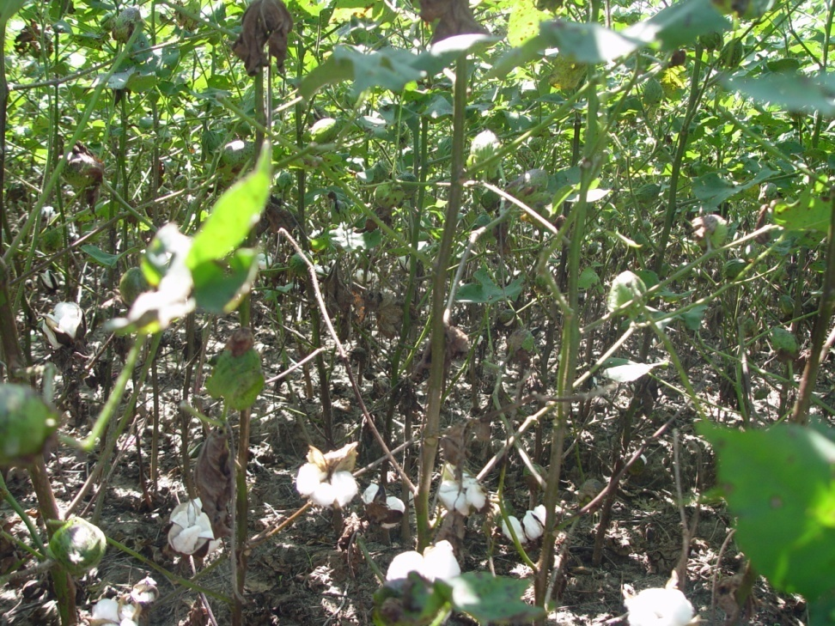
Leaf Spot Diseases in Decatur County
Corynespora Leaf Spot
(I first mis-diagnosed it as Cercospora leaf spot)

Slide 28
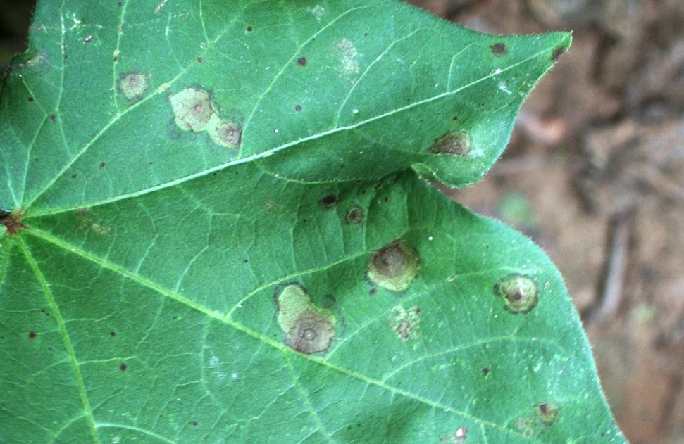
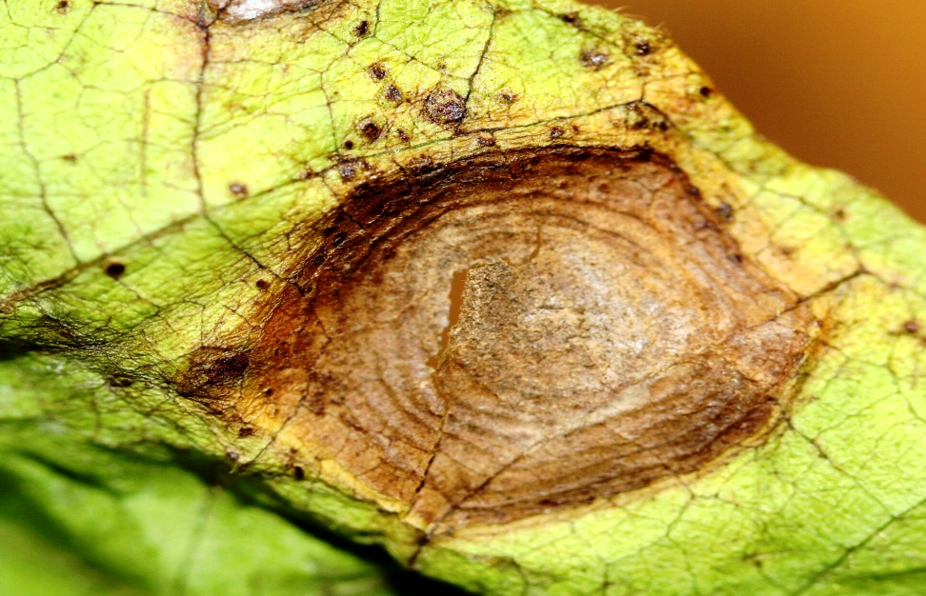
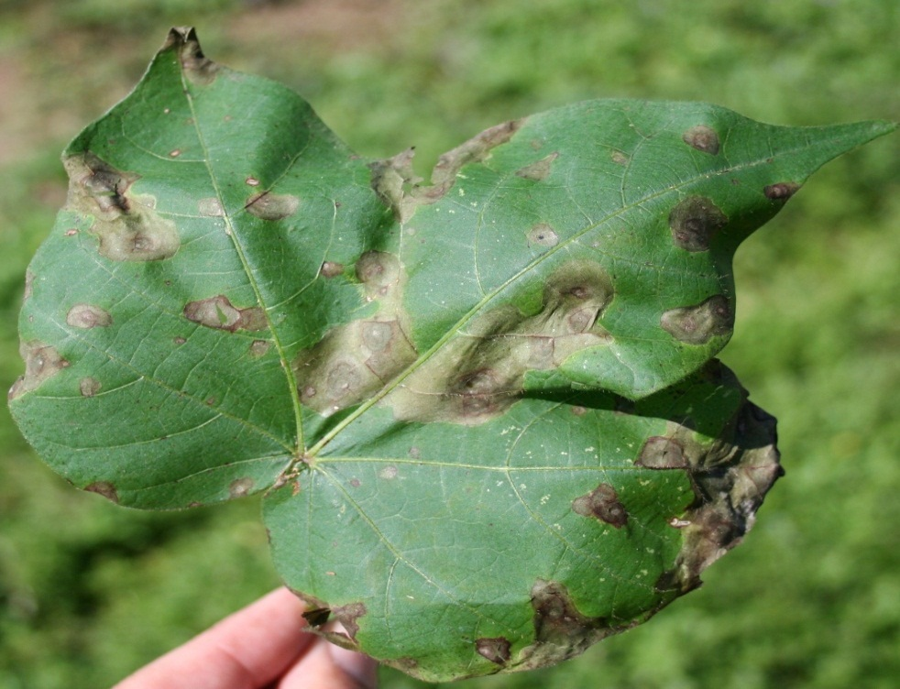
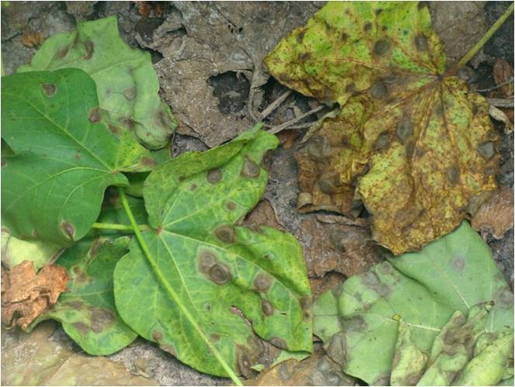

TARGET SPOT on COTTON
Target Spot Ring or Bull’s Eye’ Pattern

Slide 29
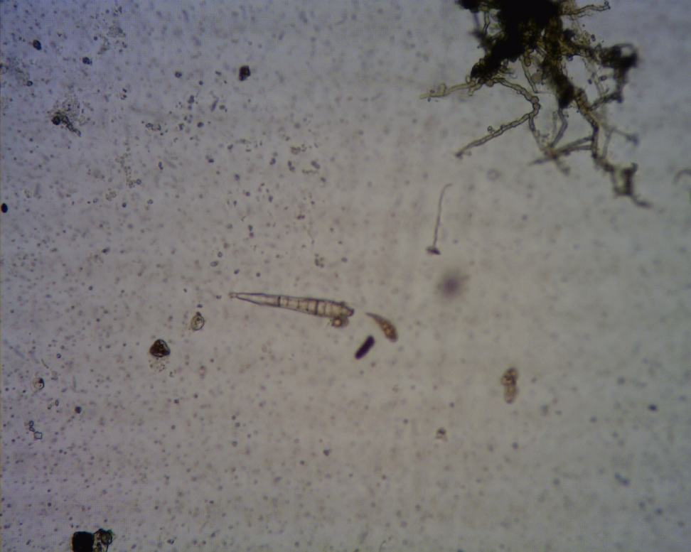
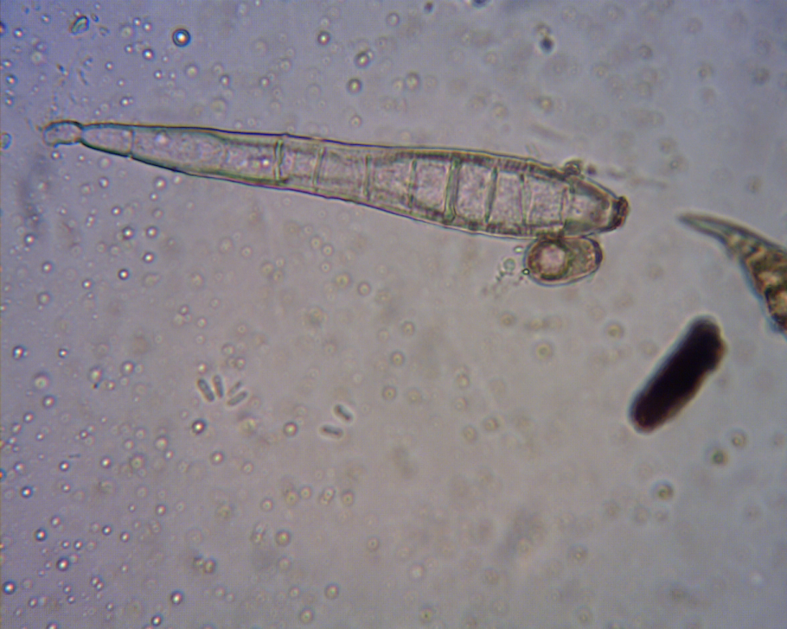
Sign of Corynespora cassiicola

Slide 30
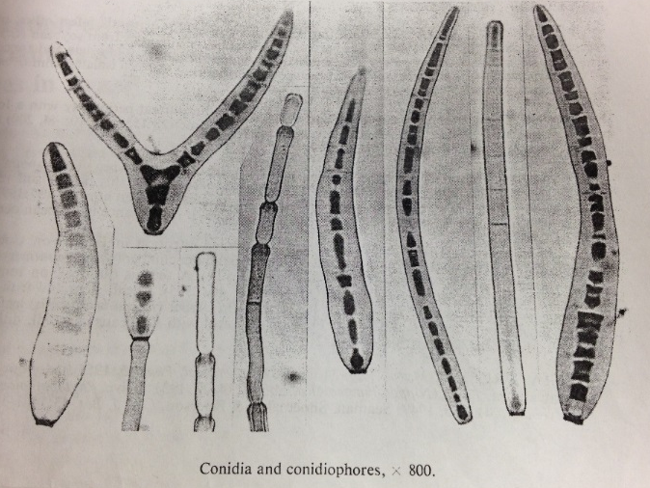
Corynespora cassiicola – The pathogen
First described as Helminthosporium cassiicola (Berk & Curtis, 1868)
Corynespora cassiicola (Wei, 1950)
Mistaken for Cercospora sp.
Kingdom: Fungi
Phylum: Ascomycota
Class: Dothideomycetes
Order: Pleosporales
Family: Corynesporaceae
C. cassiicola M.B. Ellis and P. Holiday

Slide 31
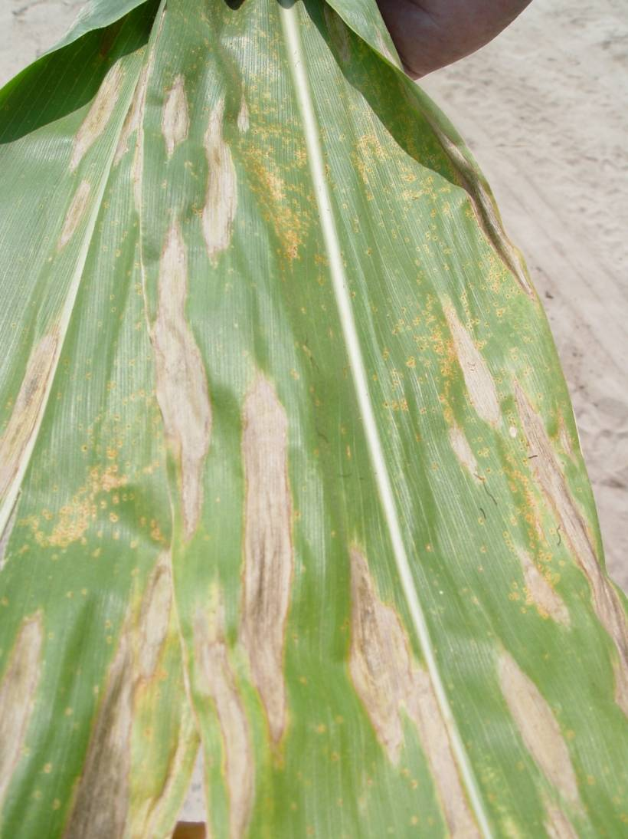
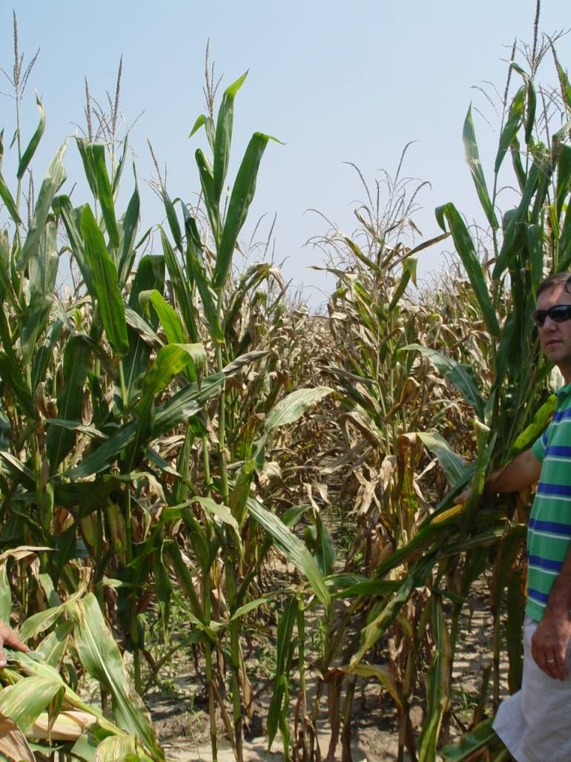
Varietal differences in NCLB

Slide 32
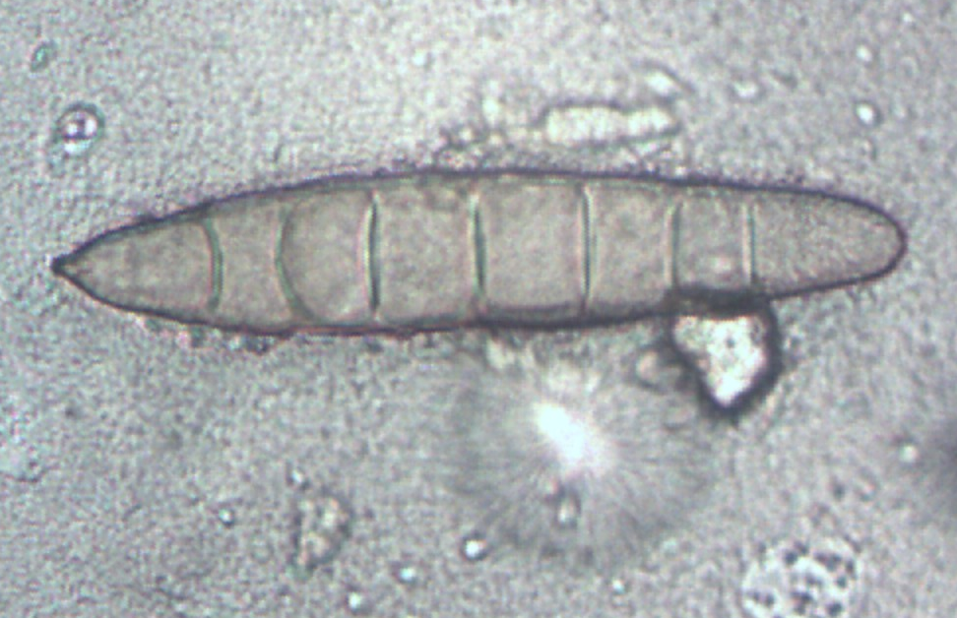
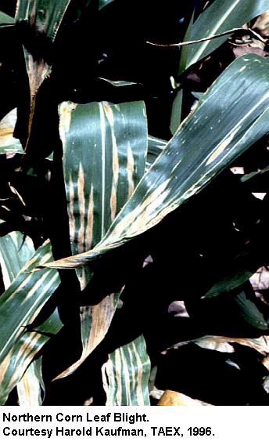
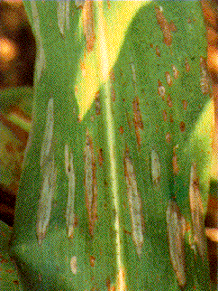
Northern Corn Leaf Blight
Exserohilum turcicum
varietal resistance
crop rotation
field sanitation
FUNGICIDES

Slide 33
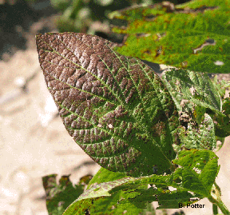
1. Cersospora Leaf Blight
2. Foliar symptoms from Dimilin
Cercospora leaf blight will cause purpling of upper foliage and petioles late in season; aslo purple seed stain.
Dimilin insecticide can cause leaves to become darker green, leathery, and cupped.
Cercospora leaf blight

Slide 34


Cercospora Leaf Blight:
The Most Important Disease in the Gulf South

Slide 35


Foliar Symptoms of Bacterial Blight

Slide 36


2015 and DPL 1454 NR B2Rf
Angular Leaf Spot - Bacterial Blight

Slide 37


Interveinal Chlorosis, Cotton

Slide 38


Slide 39
Differentiating Patterns:
Diseases and Nematodes versus Chemical Injury
Leaf spotting-
  Leaf spot diseases: typically interior of canopy, build from bottom up
  Spray injury: appears as single event in specific area of canopy; spots typically “buckskin” “washed-out” center surrounded by darker border.
Interveinal chlorosis-
  Can look like nutrient deficiency
    Dig plants and look at roots for nematode damage; collect soil samples for nematode analysis/nutrient analysis.
  Can look (to some) like chemical injury
    Look for patterns in the field; nematodes and soil fertility symptoms likely in localized areas.

Slide 40
Important Signs of Disease Pathogens-
LOOK FOR THEM!!
Sporulation- often on leaf spots, may appear as a “fuzzy” growth.
Fungal “mycelial” growth- often in the canopy of the crop.
Fruiting structures- like pycnidia, perithecia, etc.
Sclerotia (survival structures)- often look like BBs and rat droppings.

Slide 41




Peanut Rust and Late Leaf Spot

Slide 42

PEANUT RUST AND LATE LEAF SPOT
THAILAND
ARGENTINA
USA
GUYANA
PHILIPPINES

Slide 43
SOUTHERN RUST DISEASE CYCLE
(PUCCINIA POLYSORA)
OVERWINTERS
ON CORN IN MEXICO,
CARIBBEAN & C. AMERICA
SECONDARY
SPREAD BY
WIND AND RAIN
PUSTULE
DEVELOPMENT
INFECTED
PLANT
UREDIOSPORES
ARE BLOWN IN
FROM SOUTH.
WIND AND RAIN
CARRY SPORES
TO LEAVES
UREDIOSPORES ARE
PRIMARY SOURCE OF
INFECTION
SHANE SCOTT 4/97

Slide 44


